Slide 1

Lesson 04 Creating a Human-Machine Interface for an OpenPLC Program
Dr. David J. Coe
Electrical and Computer Engineering Department
University of Alabama in Huntsville
coed@uah.edu

Slide 2
Outline
Introduction
ScadaBR Installation
Creating an HMI Using ScadaBR
Configuring Data Source
Creating HMI View
Suggested Reading
Hands-On Laboratory Exercise #4

Slide 3
Introduction

Slide 4
Definition
Human-Machine Interface (HMI)
The interface used by the human operator to monitor and control operation of the PLC as it exercises control of some physical process

Slide 5
ScadaBR
An open-source tool that allows one to create a custom HMI that interacts with one or more PLCs using industry standard communication protocols such as Modbus
ScadaBR requests information from the PLC via internet packets
Contact status, coil status, etc.
PLC responds by sending the information back to ScadaBR for display

Slide 6
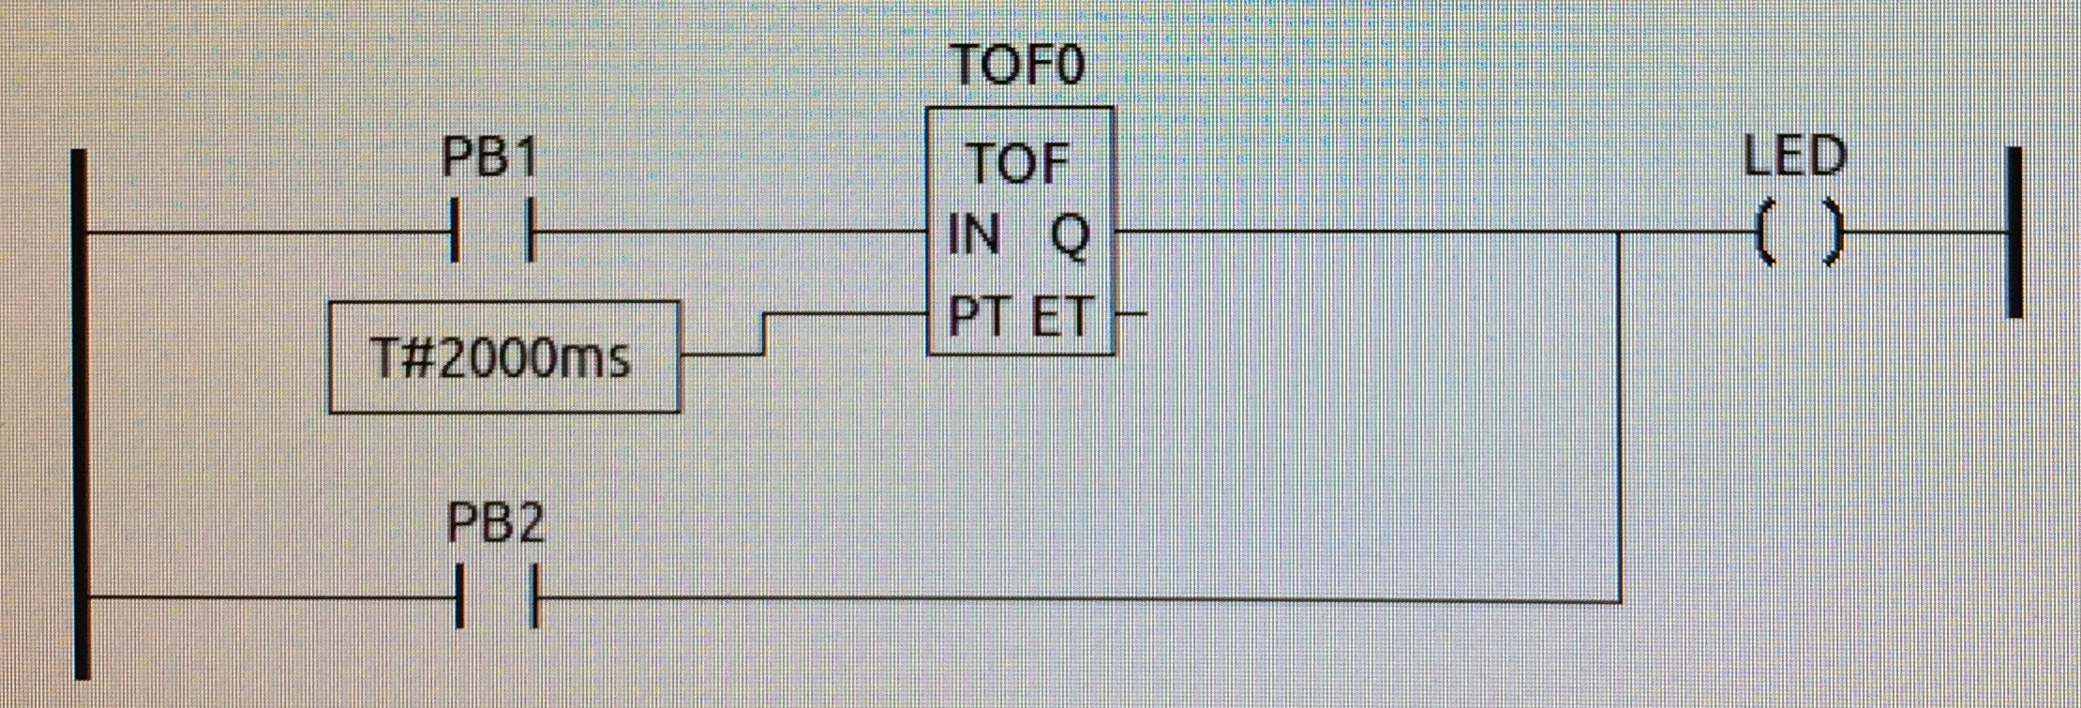
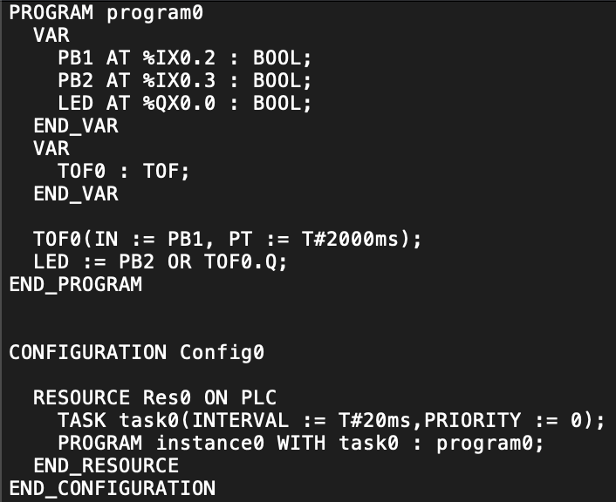
Entered / Simulated Ladder Logic and Generated Structured Text
LED lights whenever PB2 is pressed
LED lights for 2 sec after PB1 is pressed

Slide 7
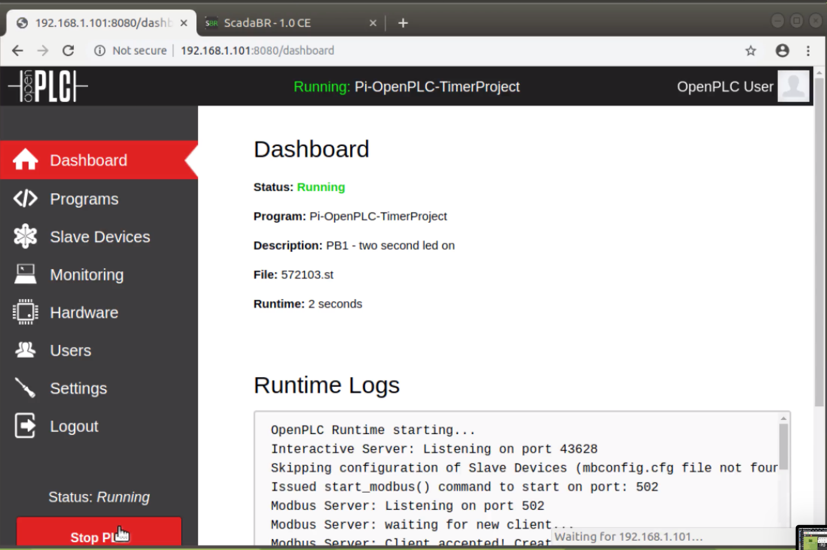
Uploaded Program Compiled and Executing on OpenPLC

Slide 8
ScadaBR Installation

Slide 9
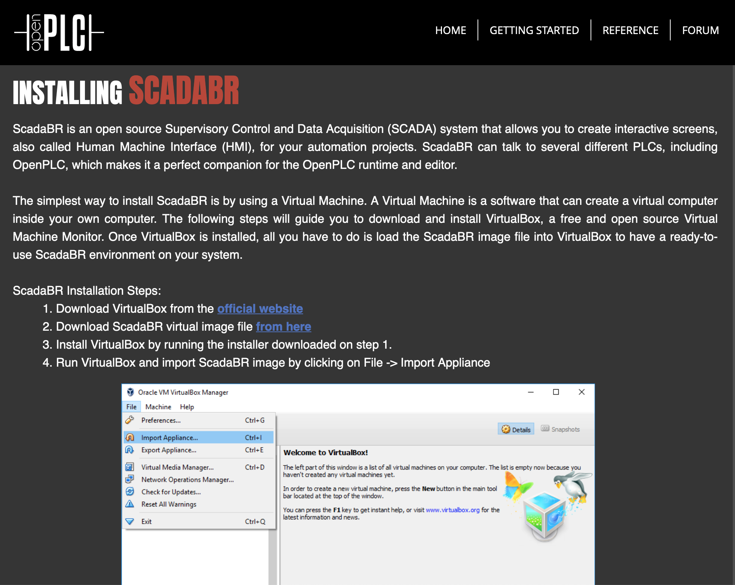
Follow OpenPLC Project Directions
https://www.openplcproject.com/reference-installing-scadabr

Slide 10
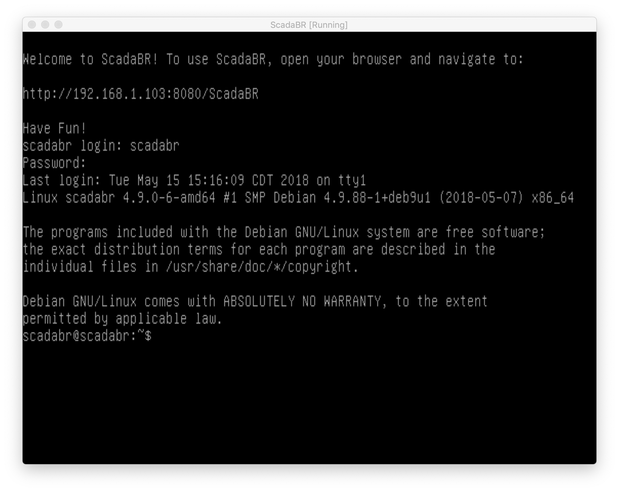
Screenshot of Pre-built ScadaBR VM
Check your network setup if no IP address visible here
https://www.openplcproject.com/reference-installing-scadabr

Slide 11
Creating an HMI Using ScadaBR

Slide 12
HMI Creation with ScadaBR
Start your OpenPLC program running on your OpenPLC virtual or physical instance
Use your browser to access URL
ScadaBR-IP-Here:8080/ScadaBR
Login using username admin / password admin
Configure and enable data source
Create an HMI view to show PLC program status

Slide 13
Configuration of Data Source

Slide 14
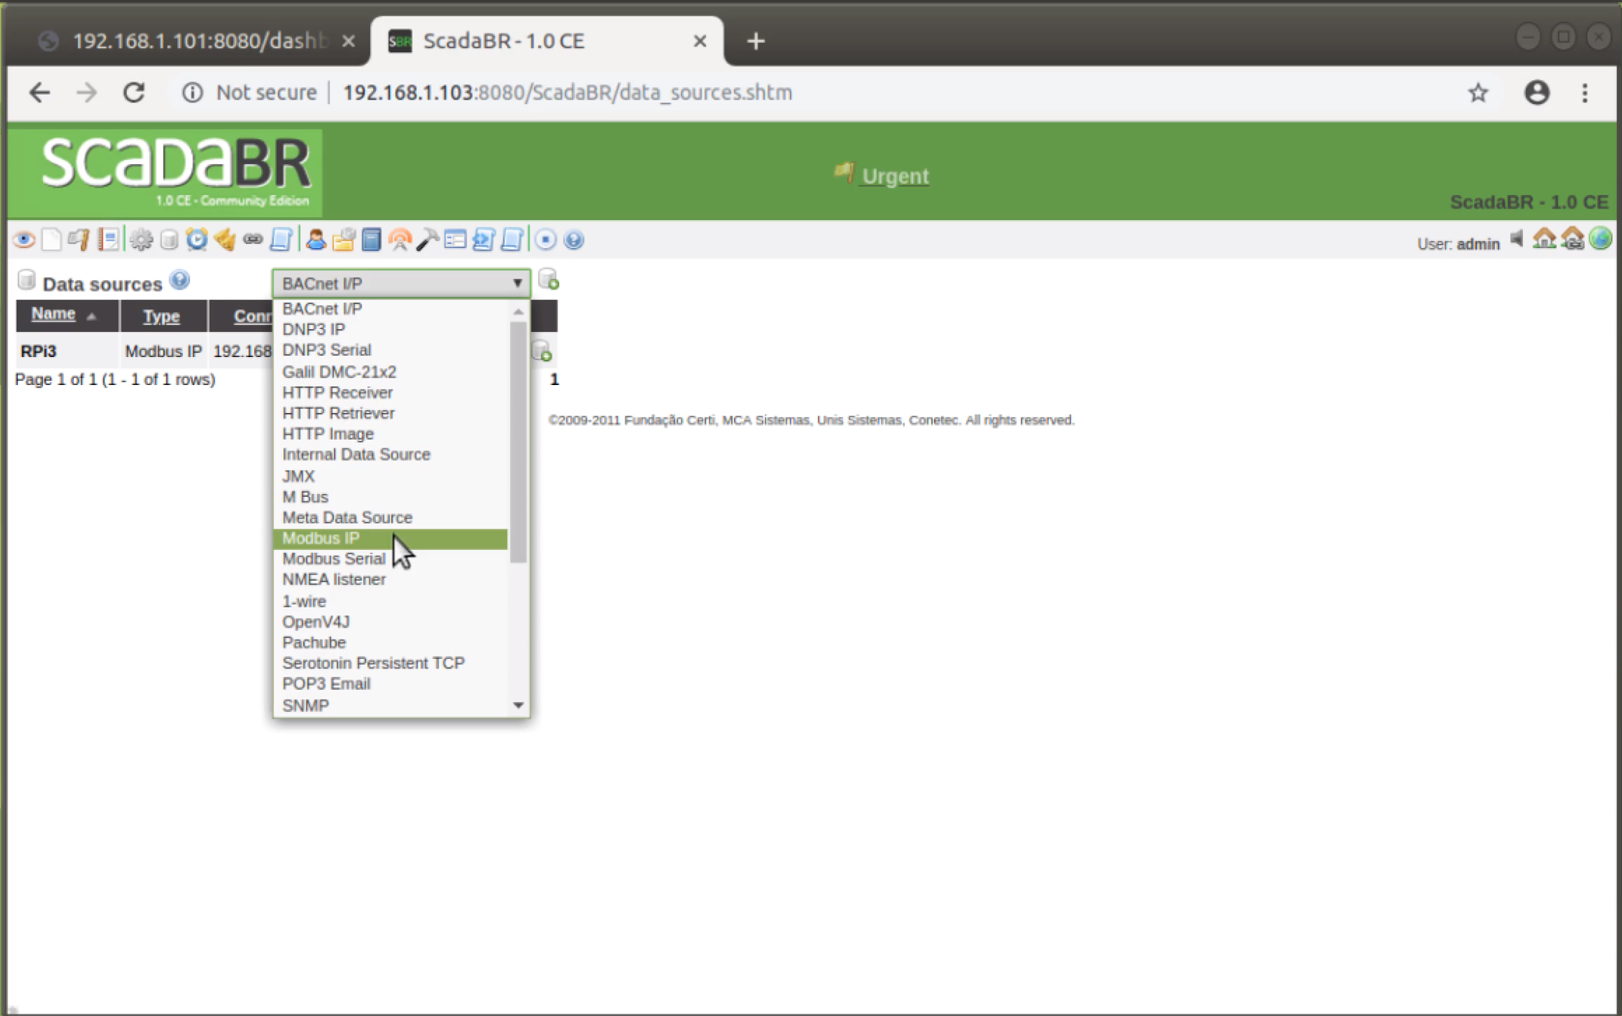
Configuration of Data Source - 1
From the View tab, select Modbus IP option

Slide 15
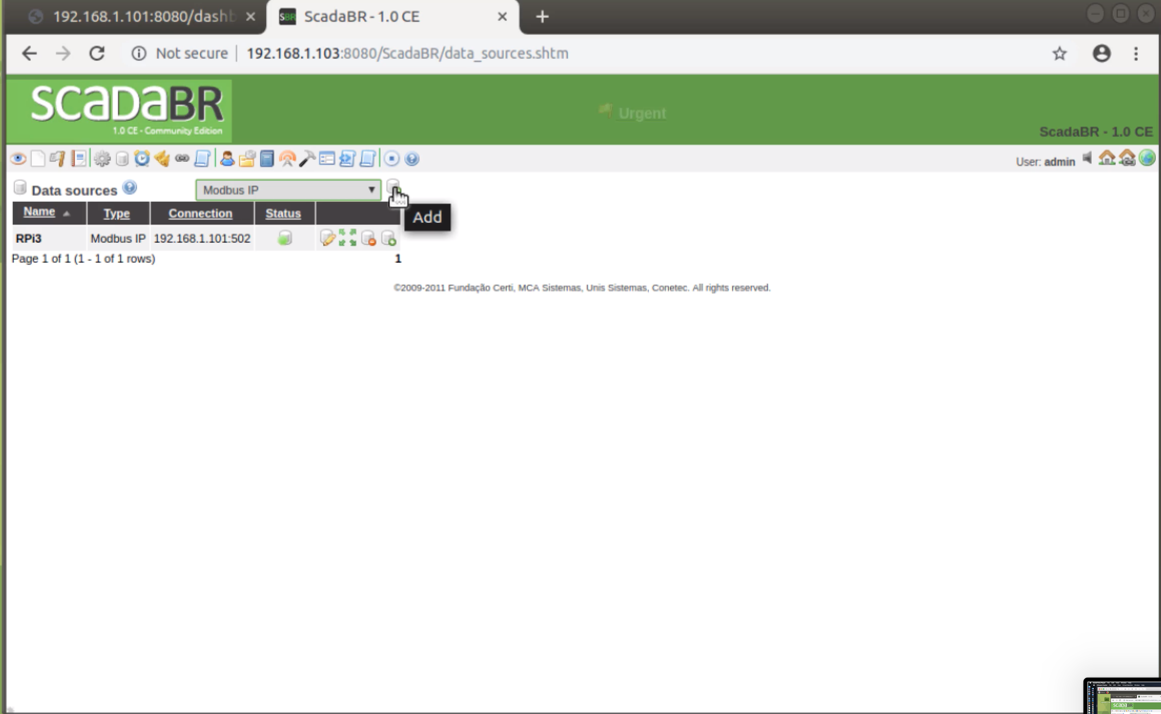
Configuration of Data Source - 2
From the View tab, select Add option to create a new view

Slide 16
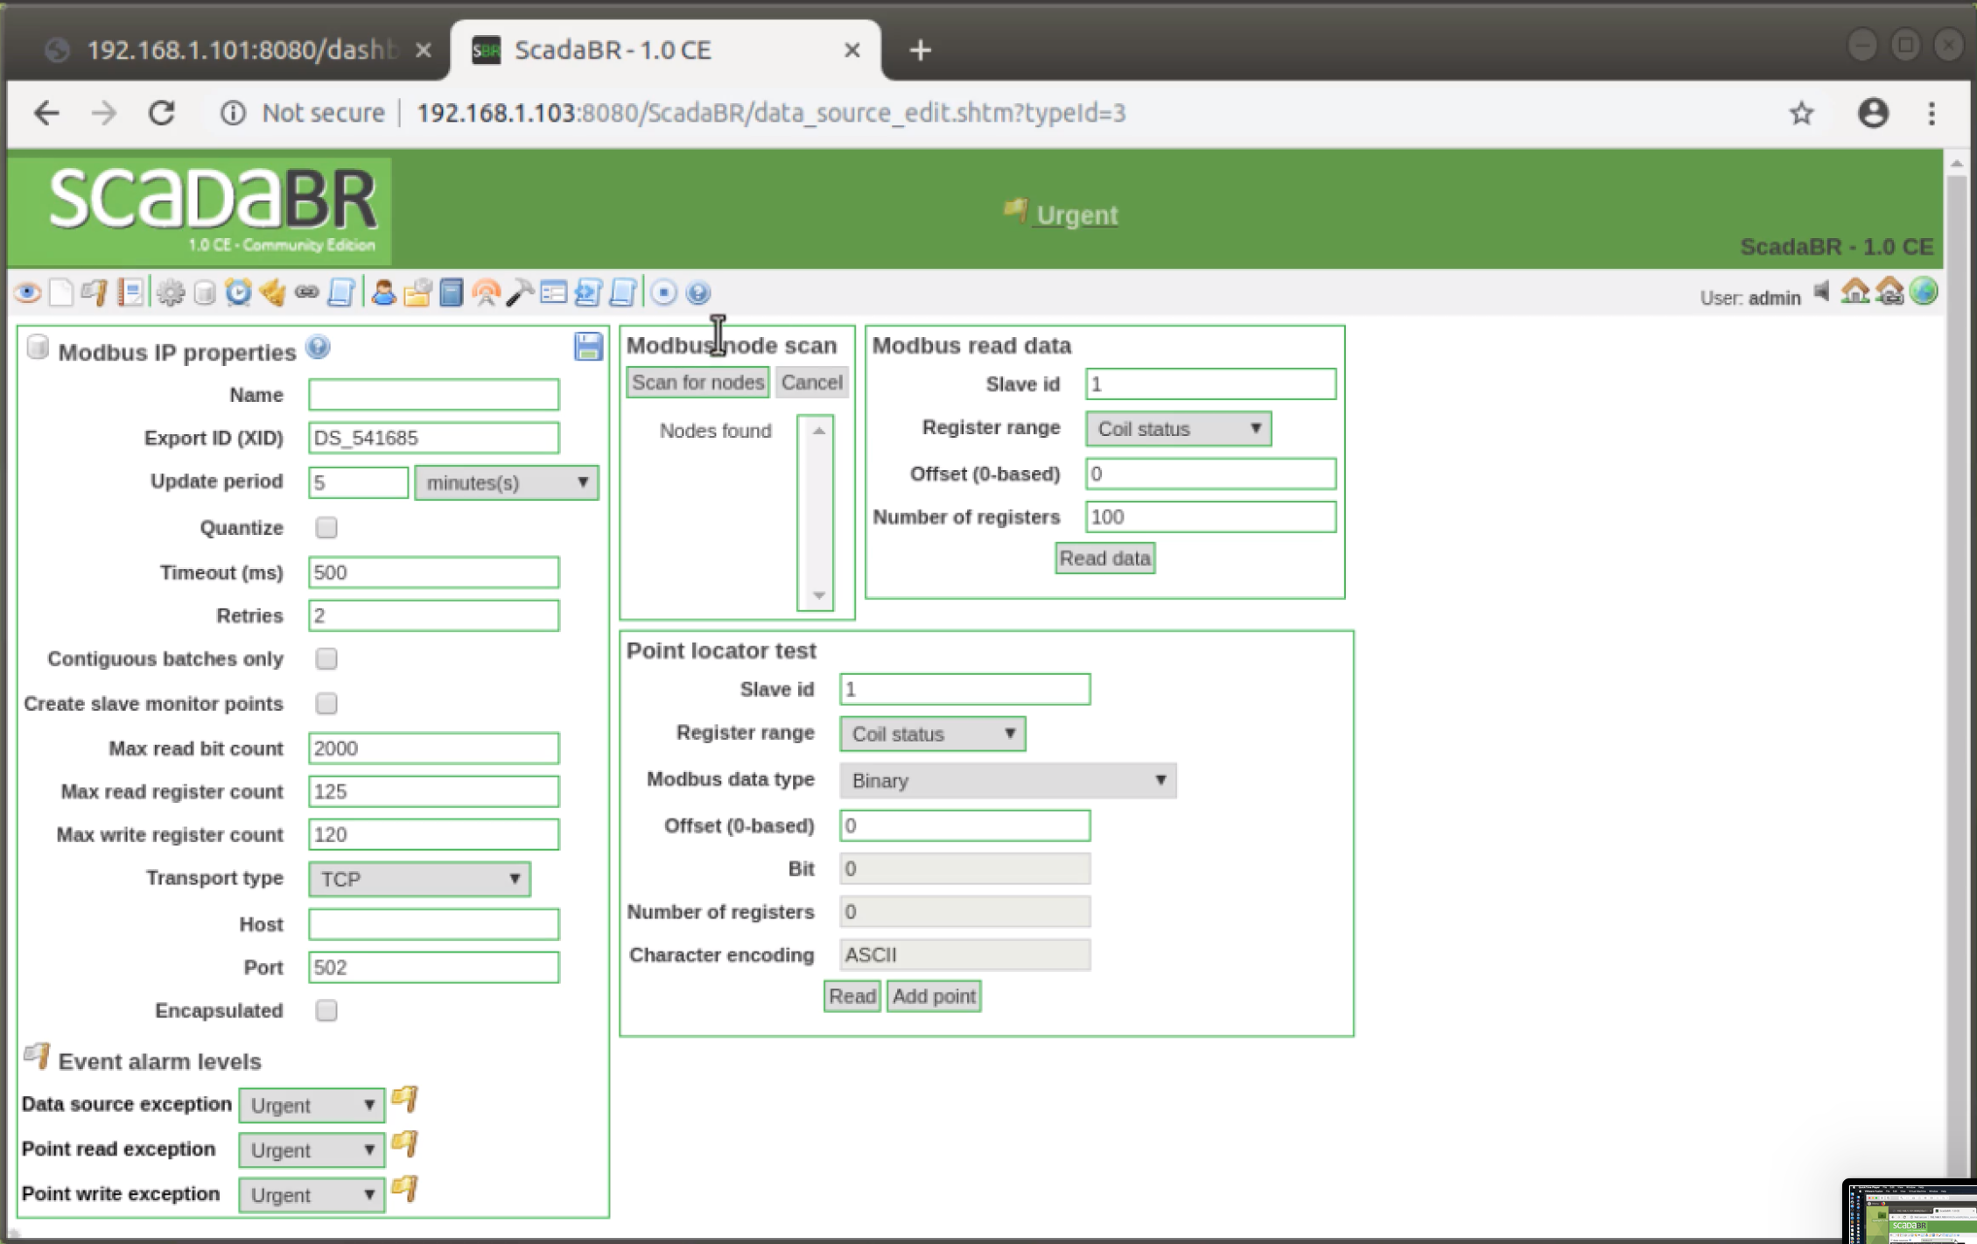
Configuration of Data Source - 3
View configuration options

Slide 17
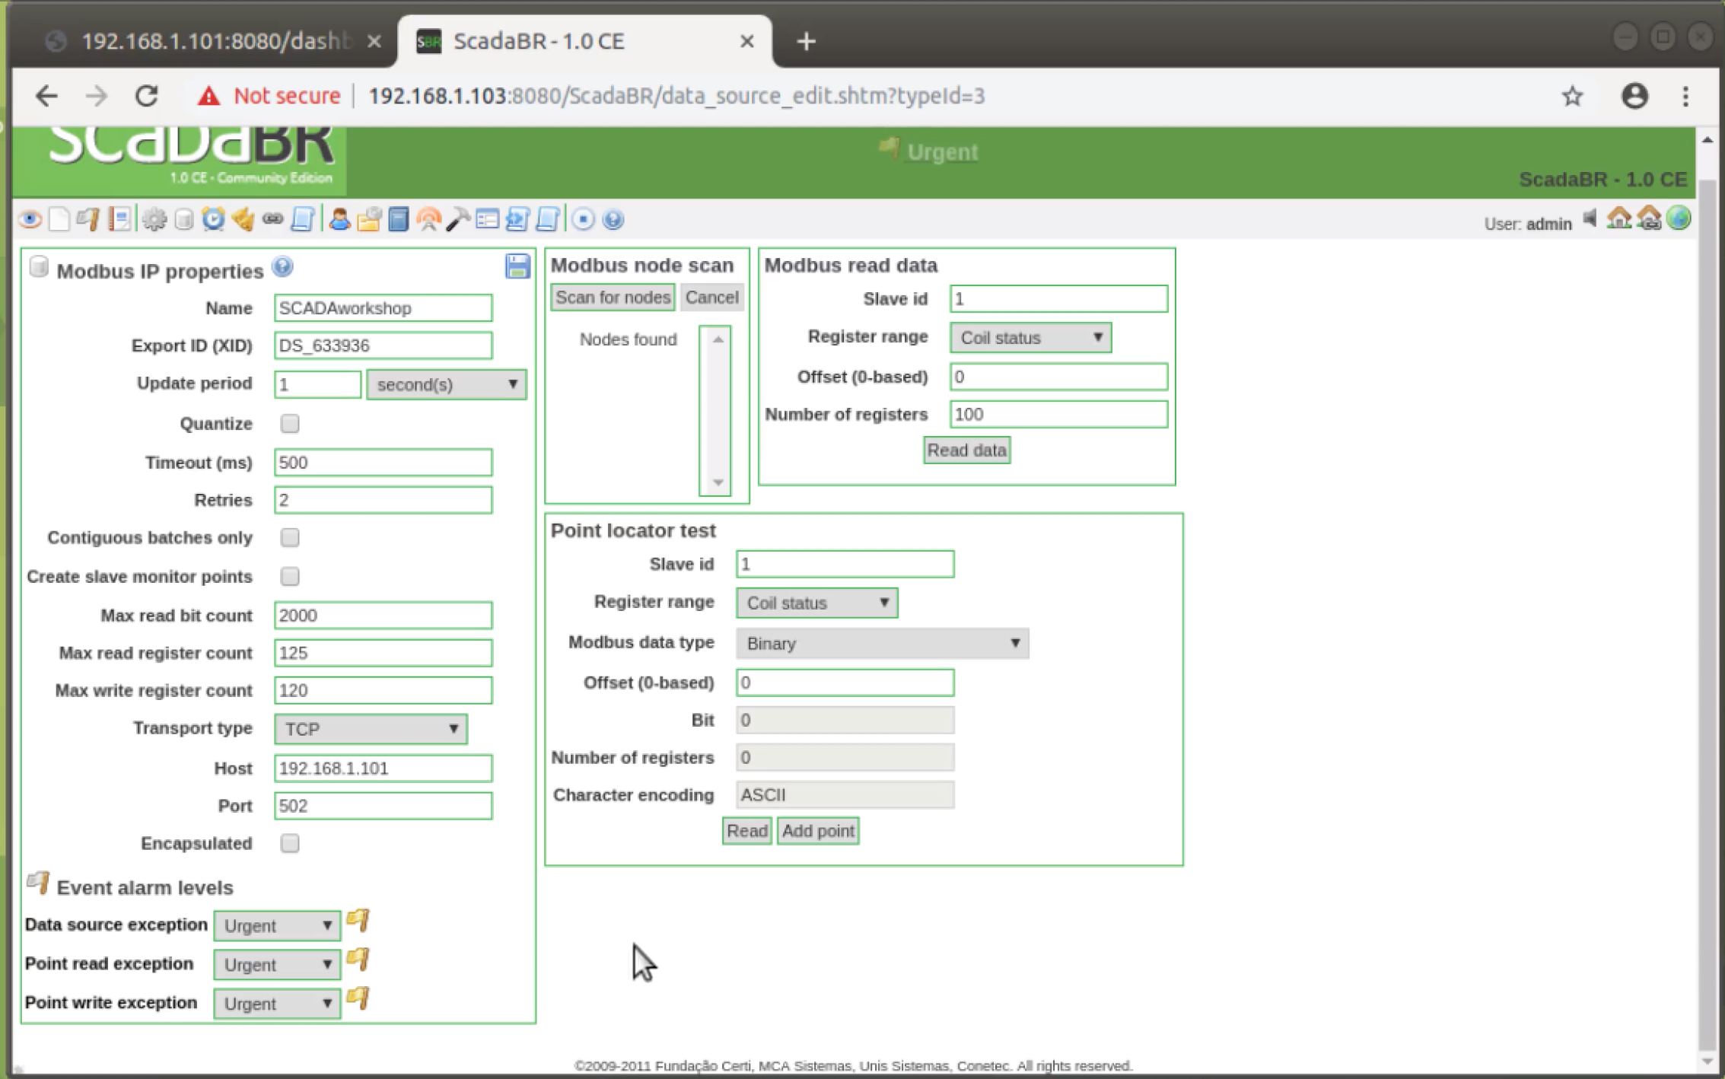
Configuration of Data Source - 4
Set name, host, and update period options
Hit Save icon
For Transport type, TCP works, TCP with Keep-Alive is more reliable

Slide 18
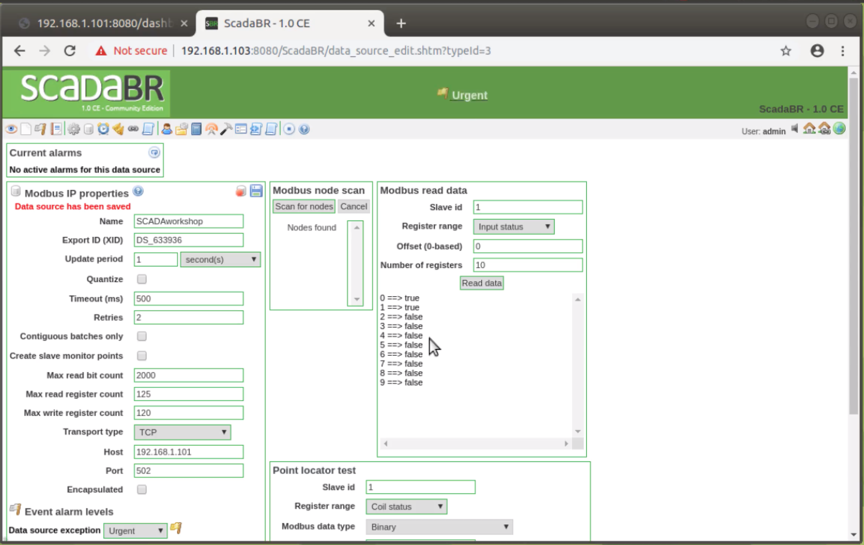
Configuration of Data Source - 5
Set number of registers to 10 and register range to Input status

Slide 19


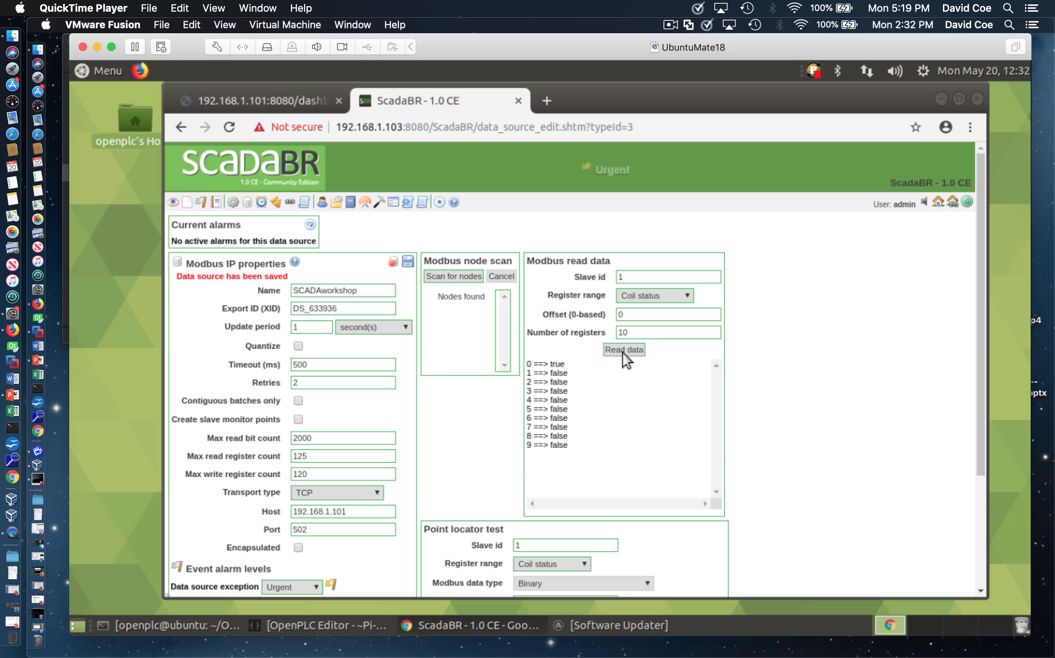

Configuration of Data Source - 6
Verify Push Button #2 input status change
Verify LED output status change
Test ScadaBR to OpenPLC connectivity
Hit Read Data icon with and without holding push buttons (input status)
Repeat for LED (change register range to output status)
If you see state change, then ScadaBR is interacting with OpenPLC

Slide 20
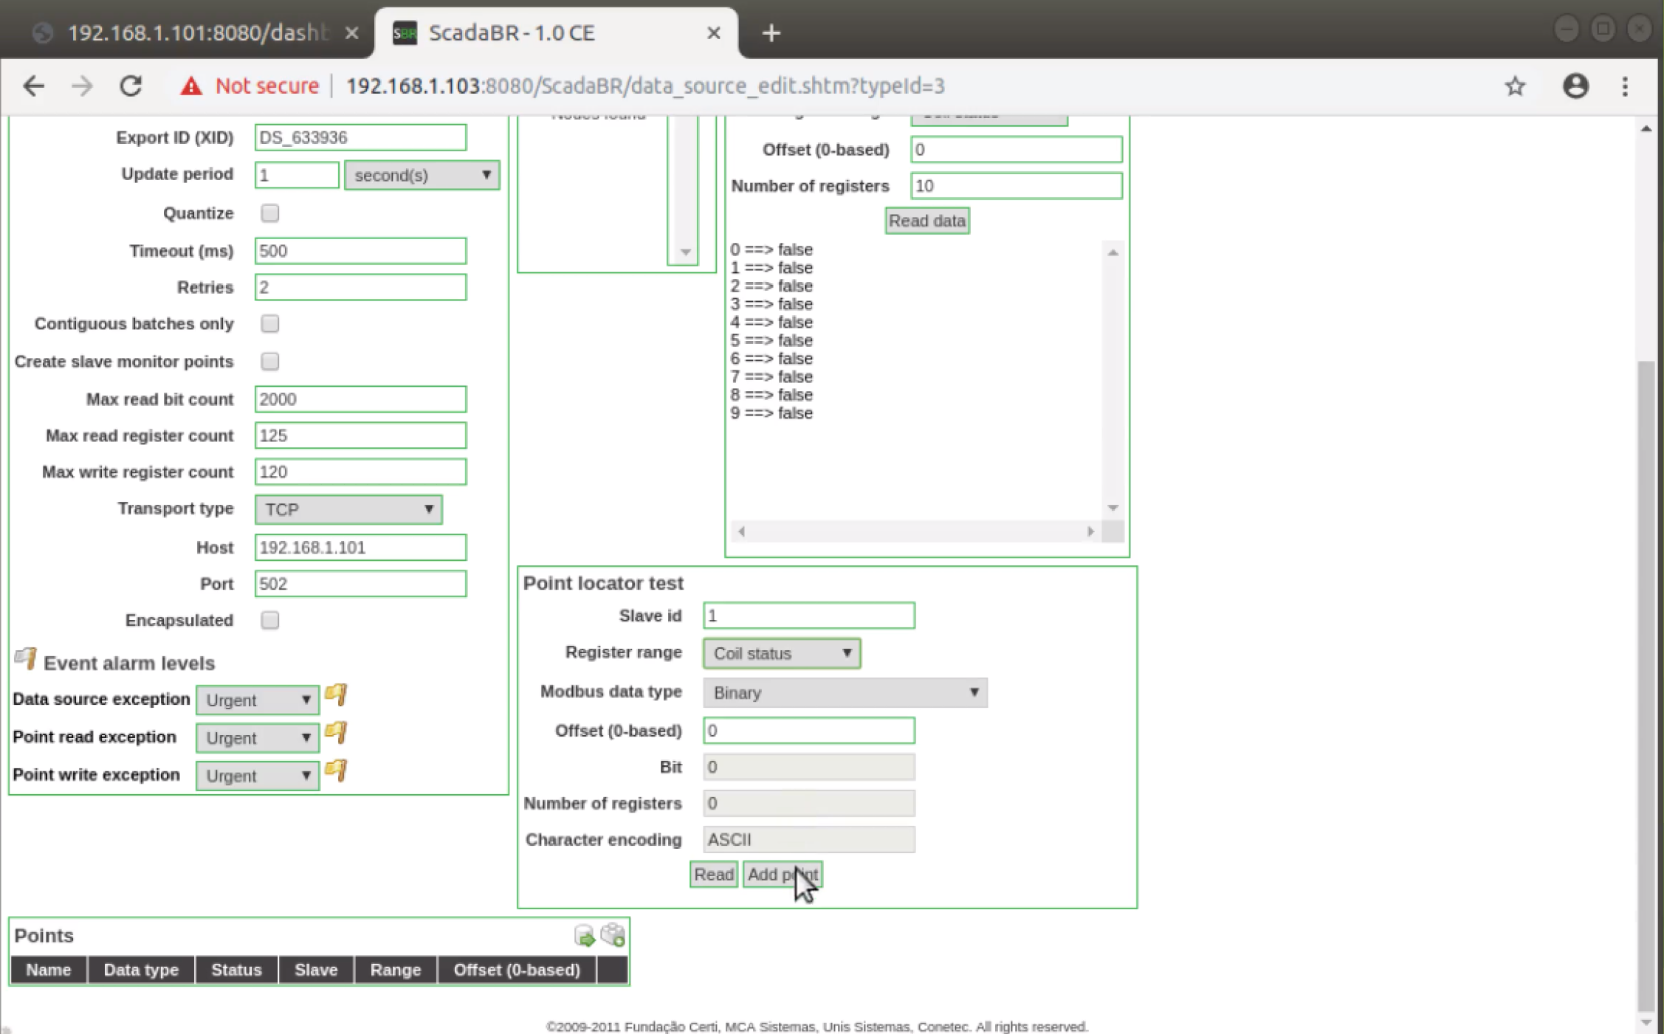
Configuration of Data Source - 7
ScadaBR has been correctly configured to communicate with OpenPLC
Now we need to select specific data points to monitor via the HMI
Scroll down and hit Add point

Slide 21
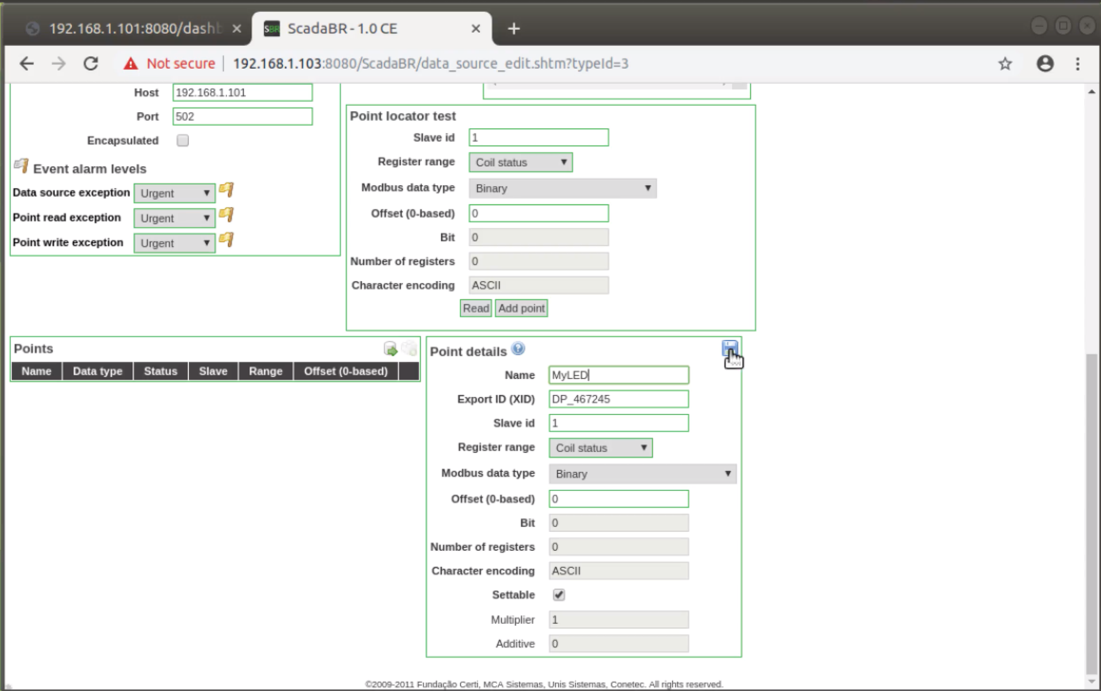
Configuration of Data Source - 8
Enter name of output coil LED
Set Register range to coil status
Scroll down and hit Save icon

Slide 22
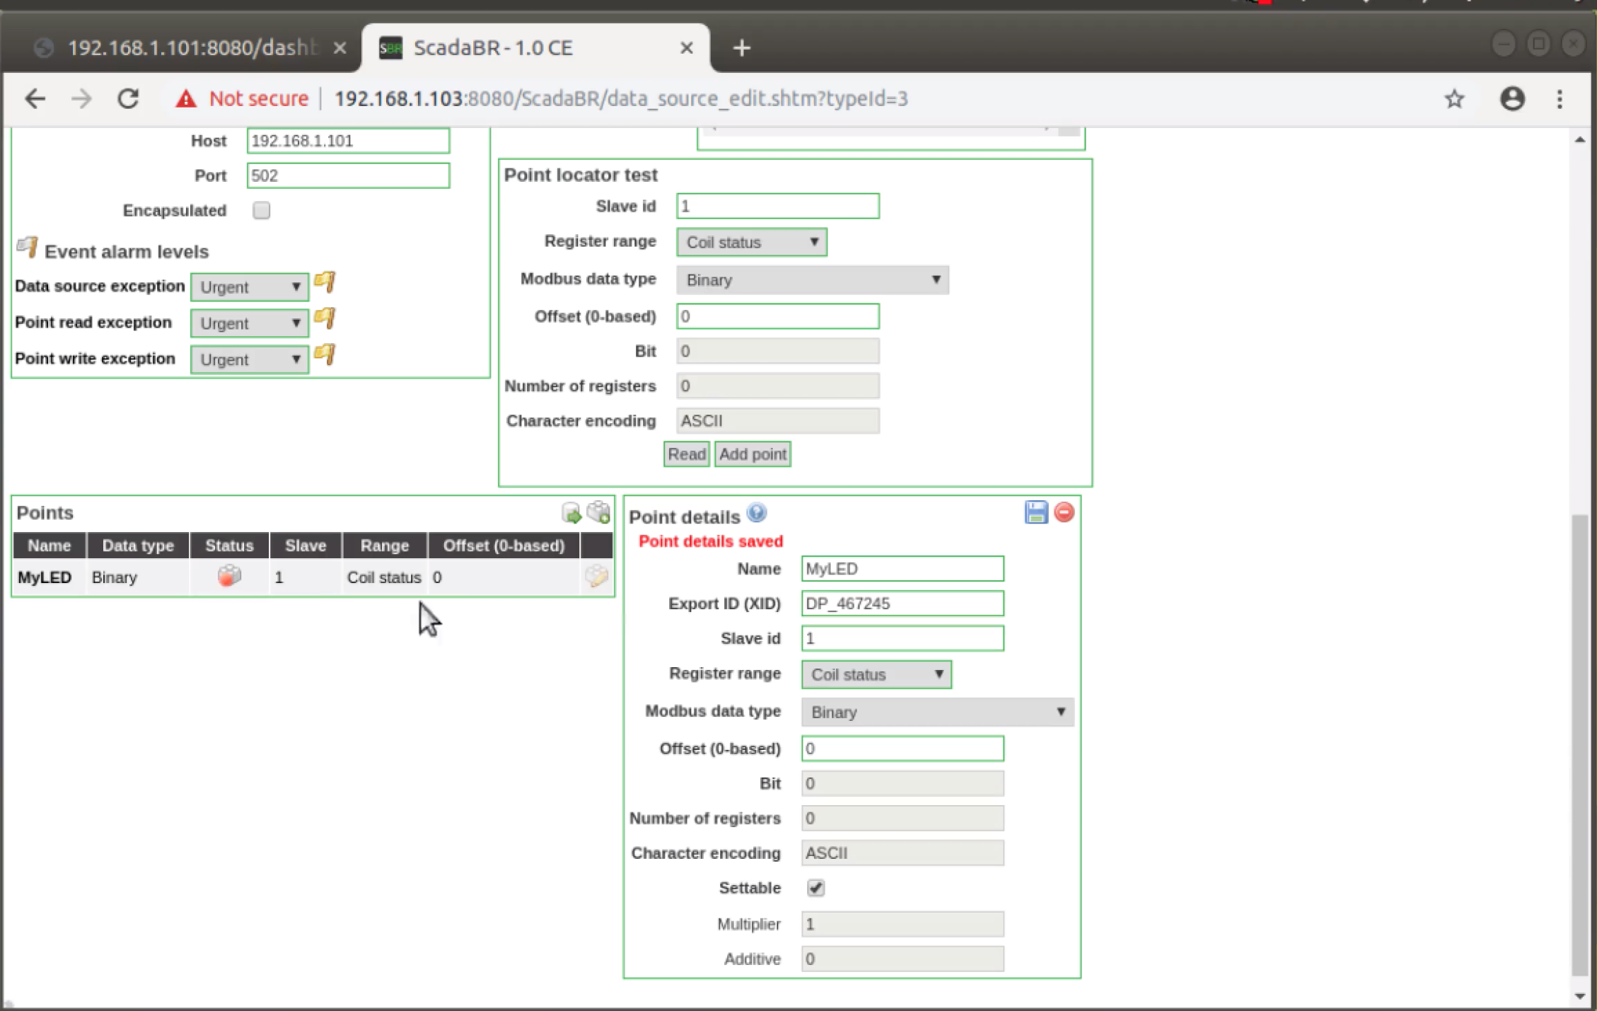
Configuration of Data Source - 9
MyLED point row added
Status is by default disabled
Click icon under Status to enable

Slide 23
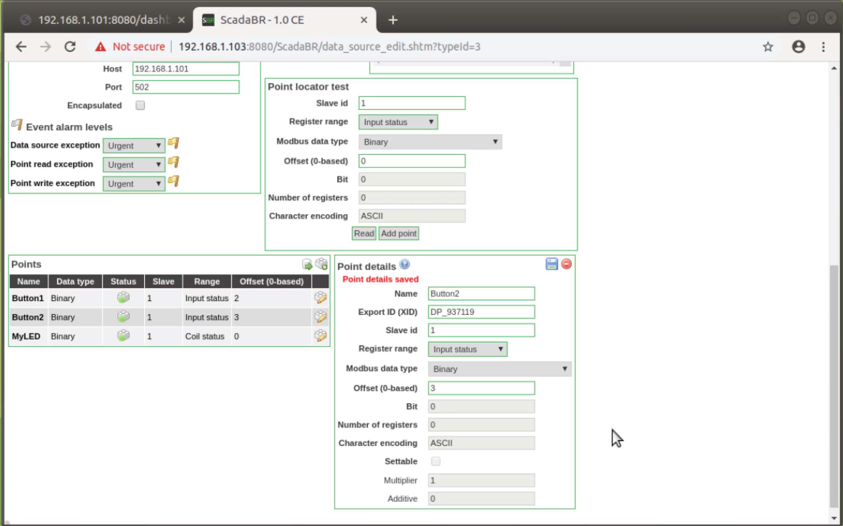
Configuration of Data Source - 10
Repeat Add point for Button1 and Button2
Be sure to change Register range to Input status
Click icons under Status to enable

Slide 24
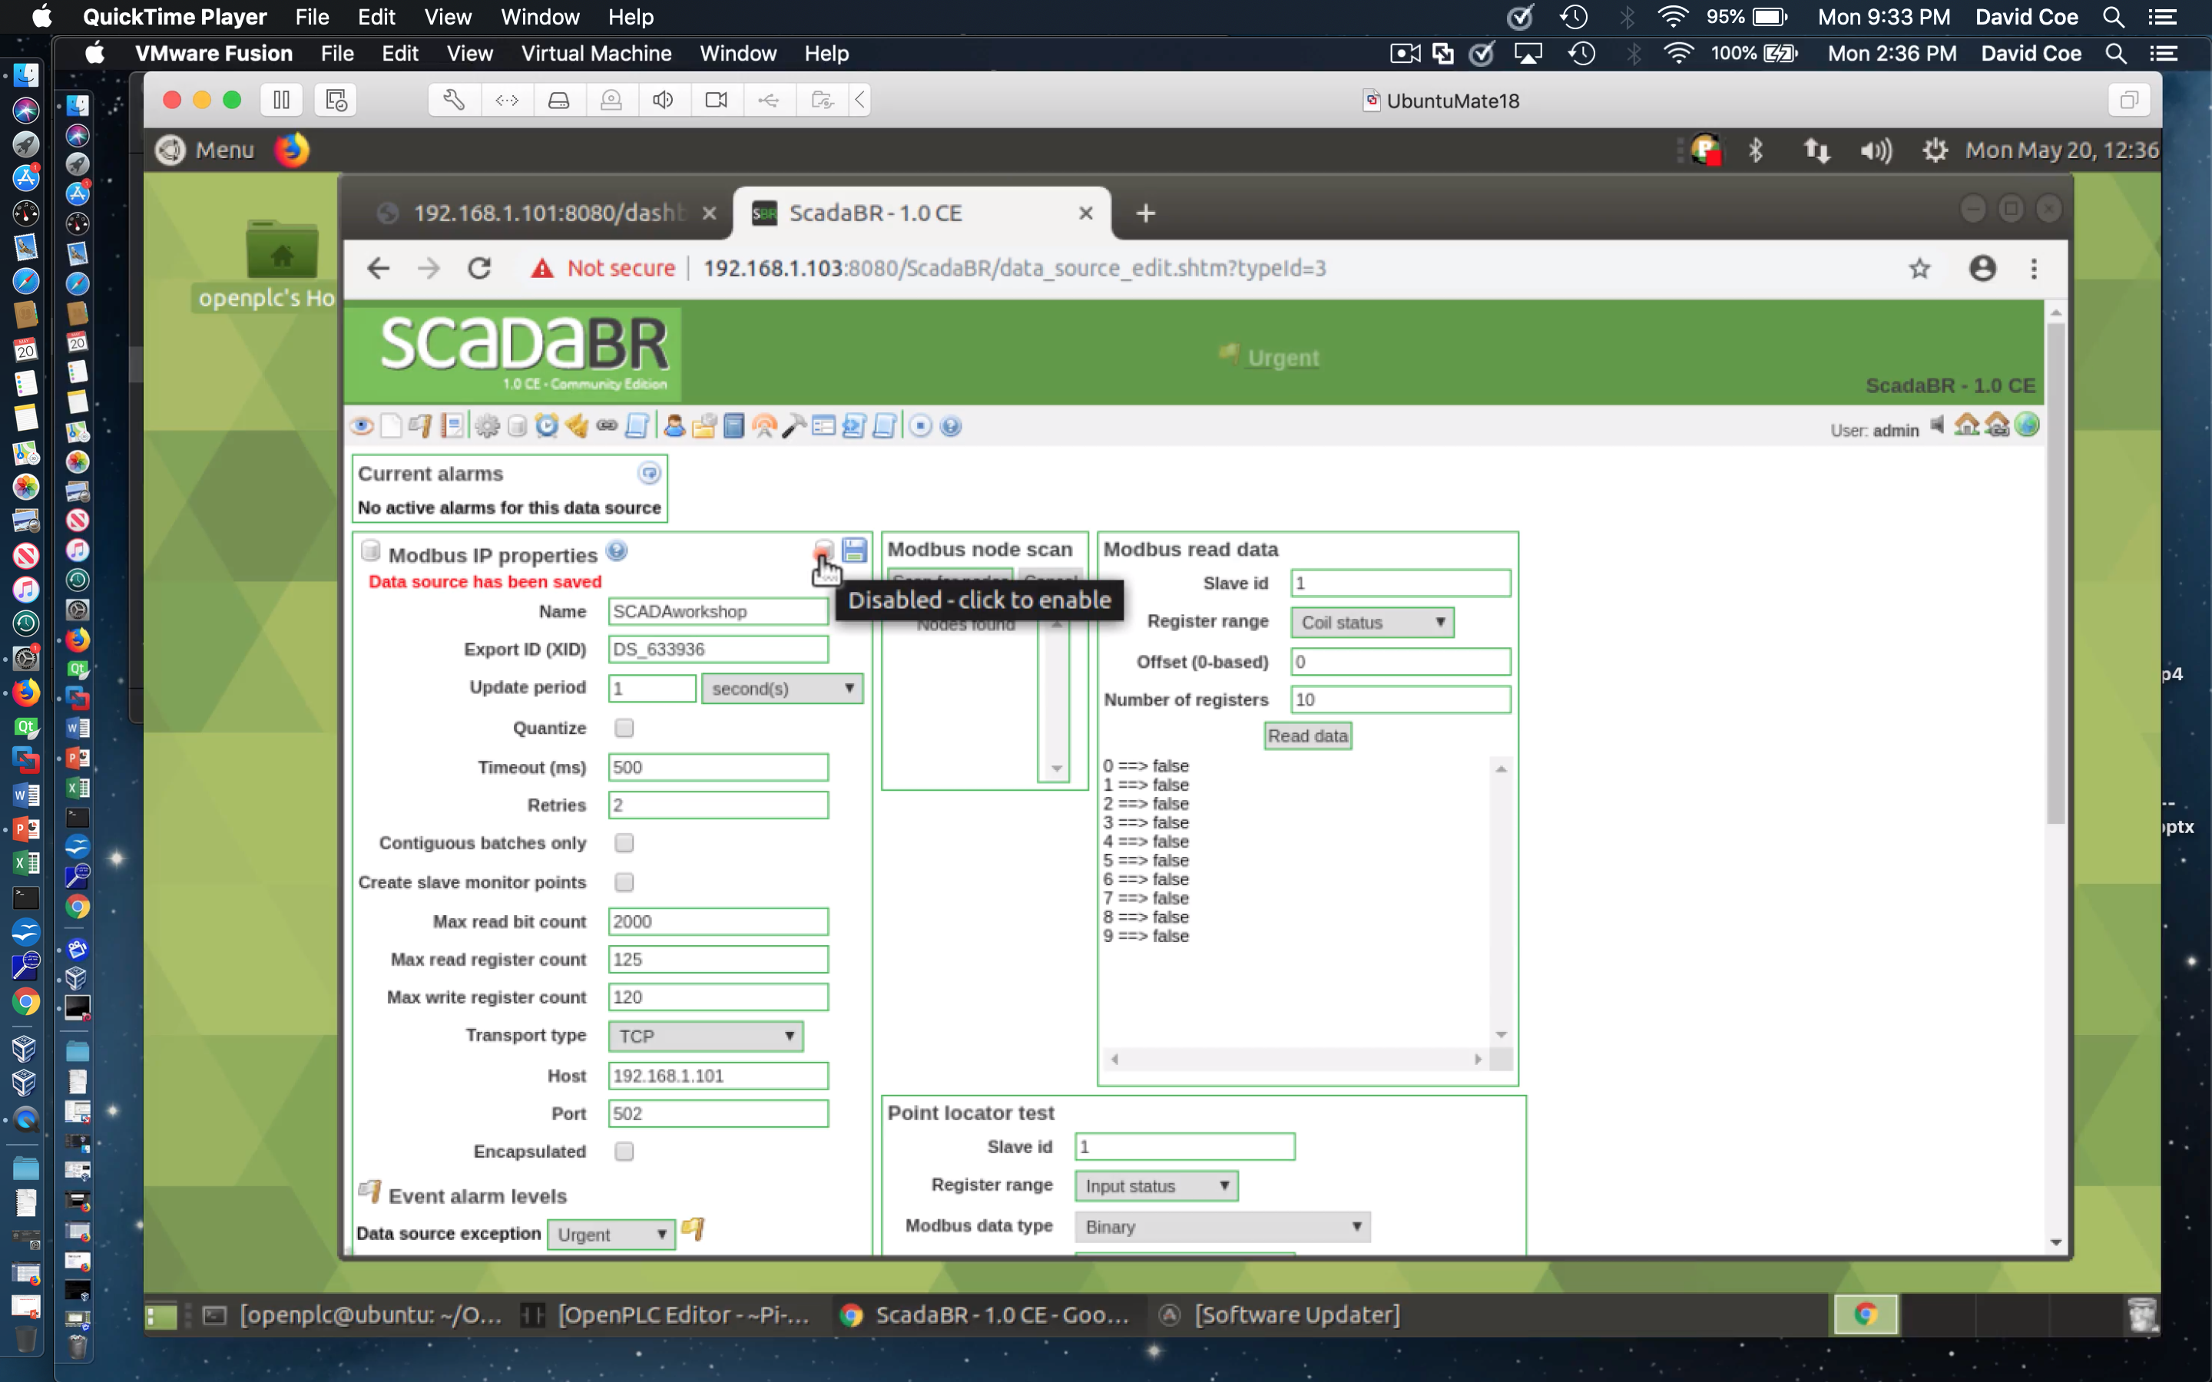
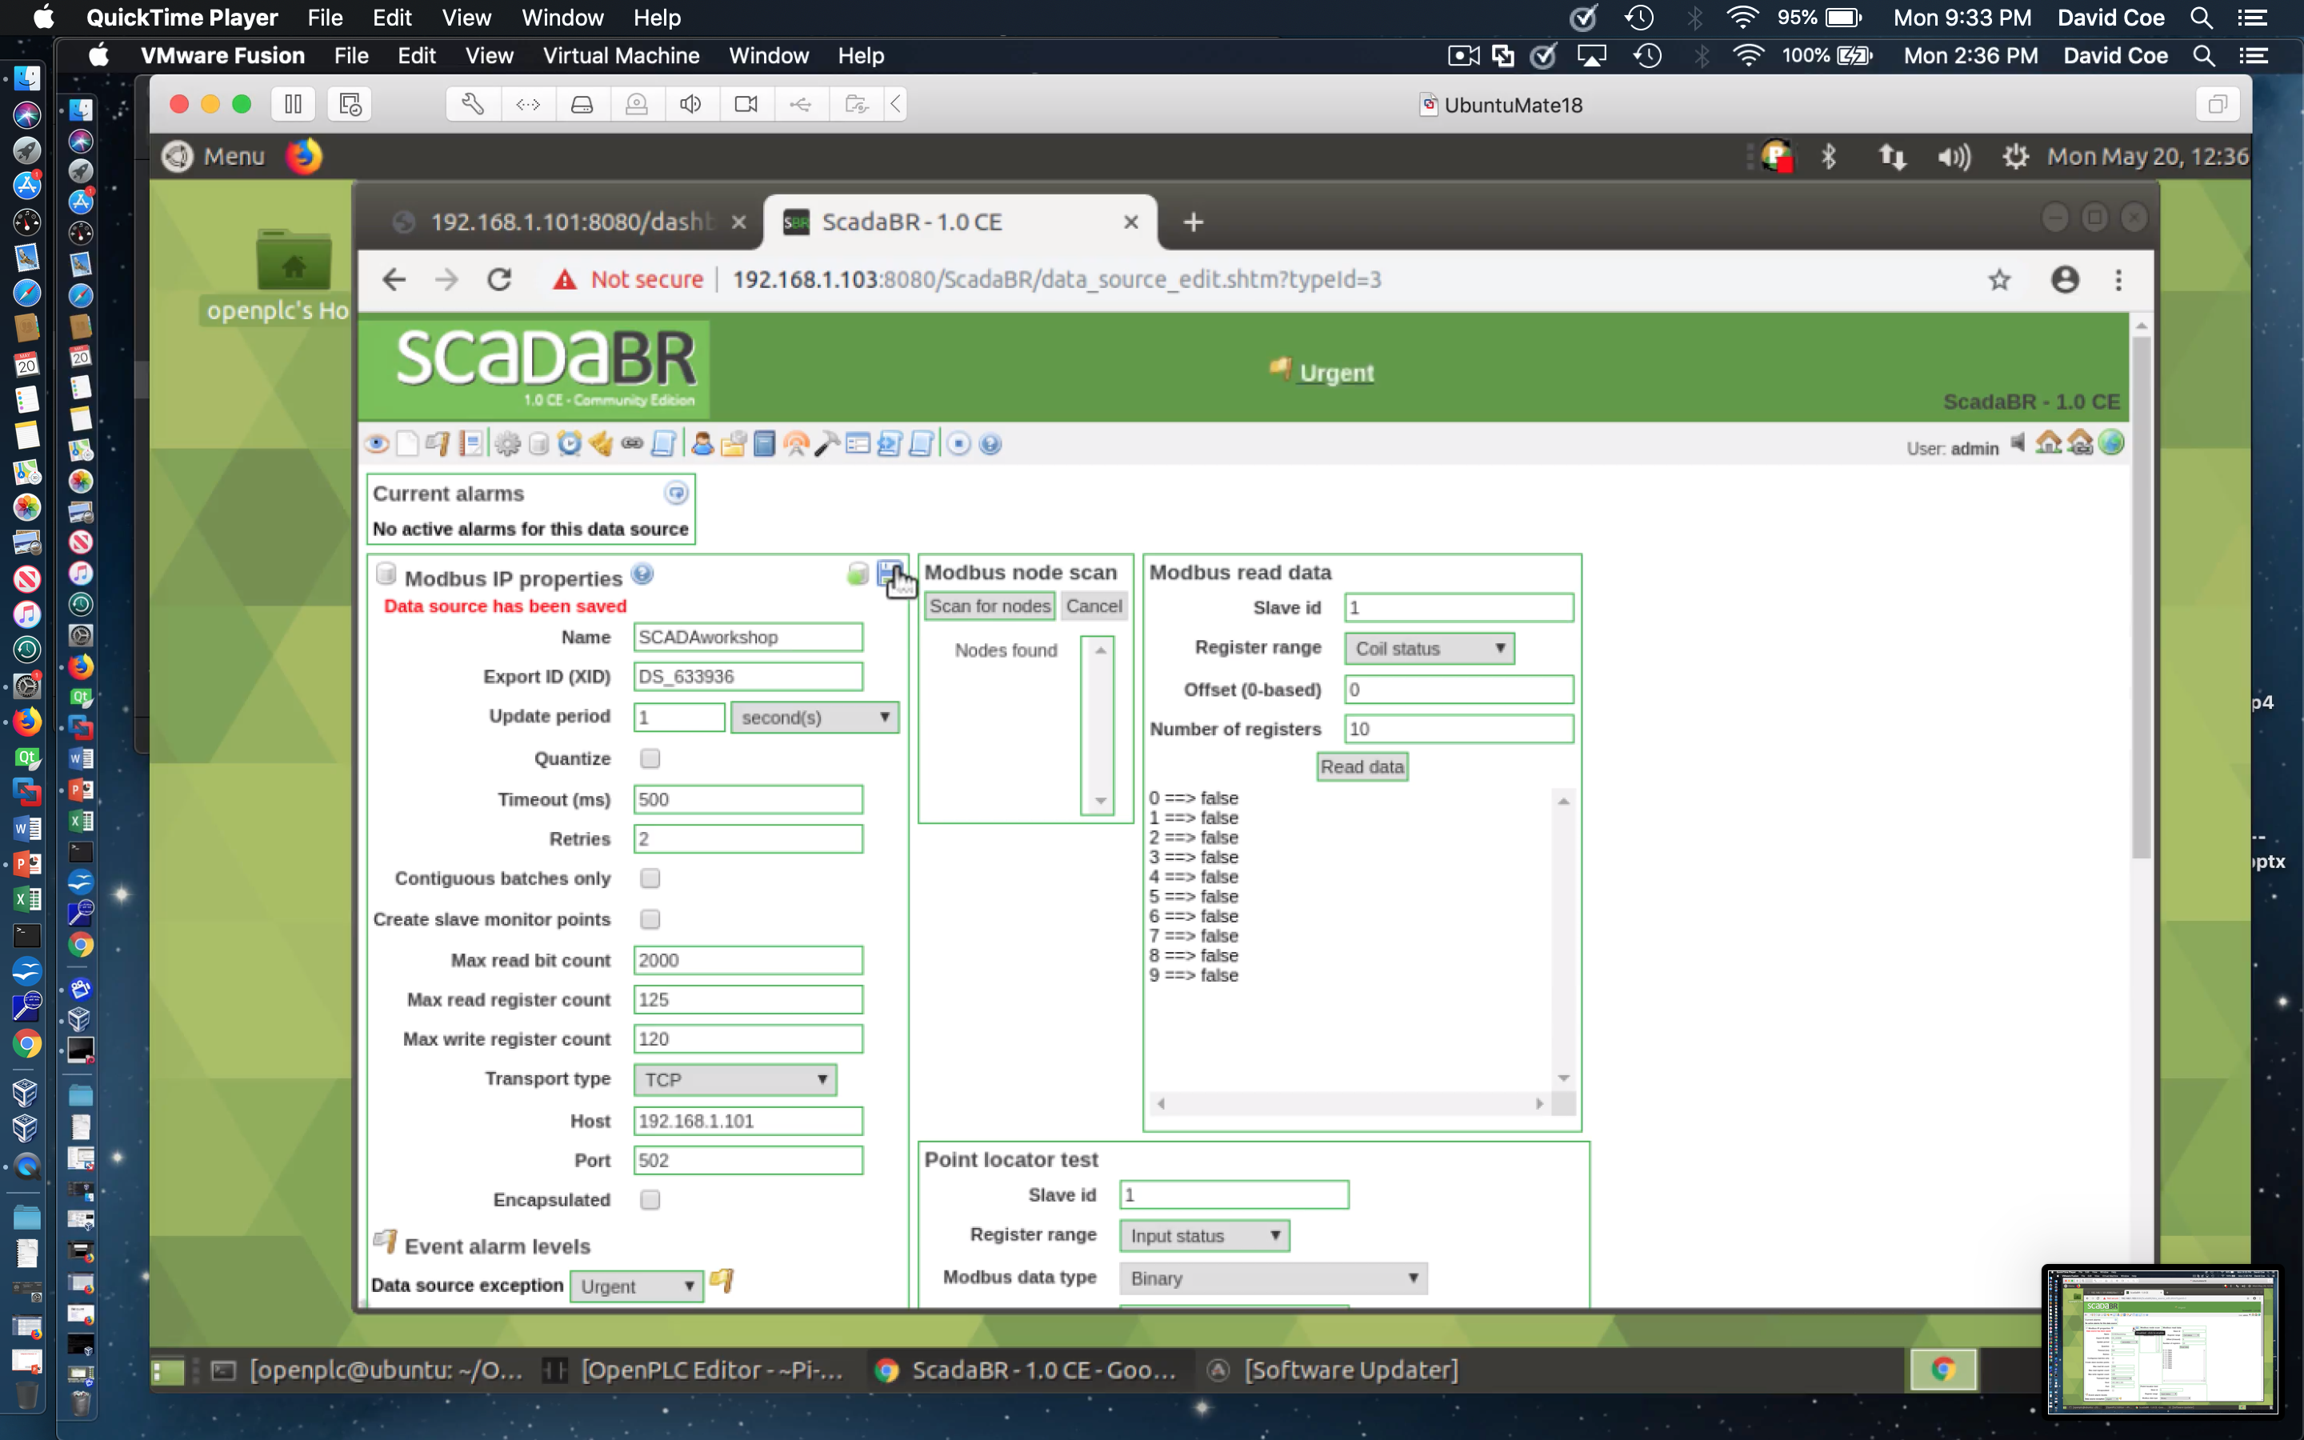
Configuration of Data Source - 11
Click enable icon next to save icon
Click Save icon

Slide 25
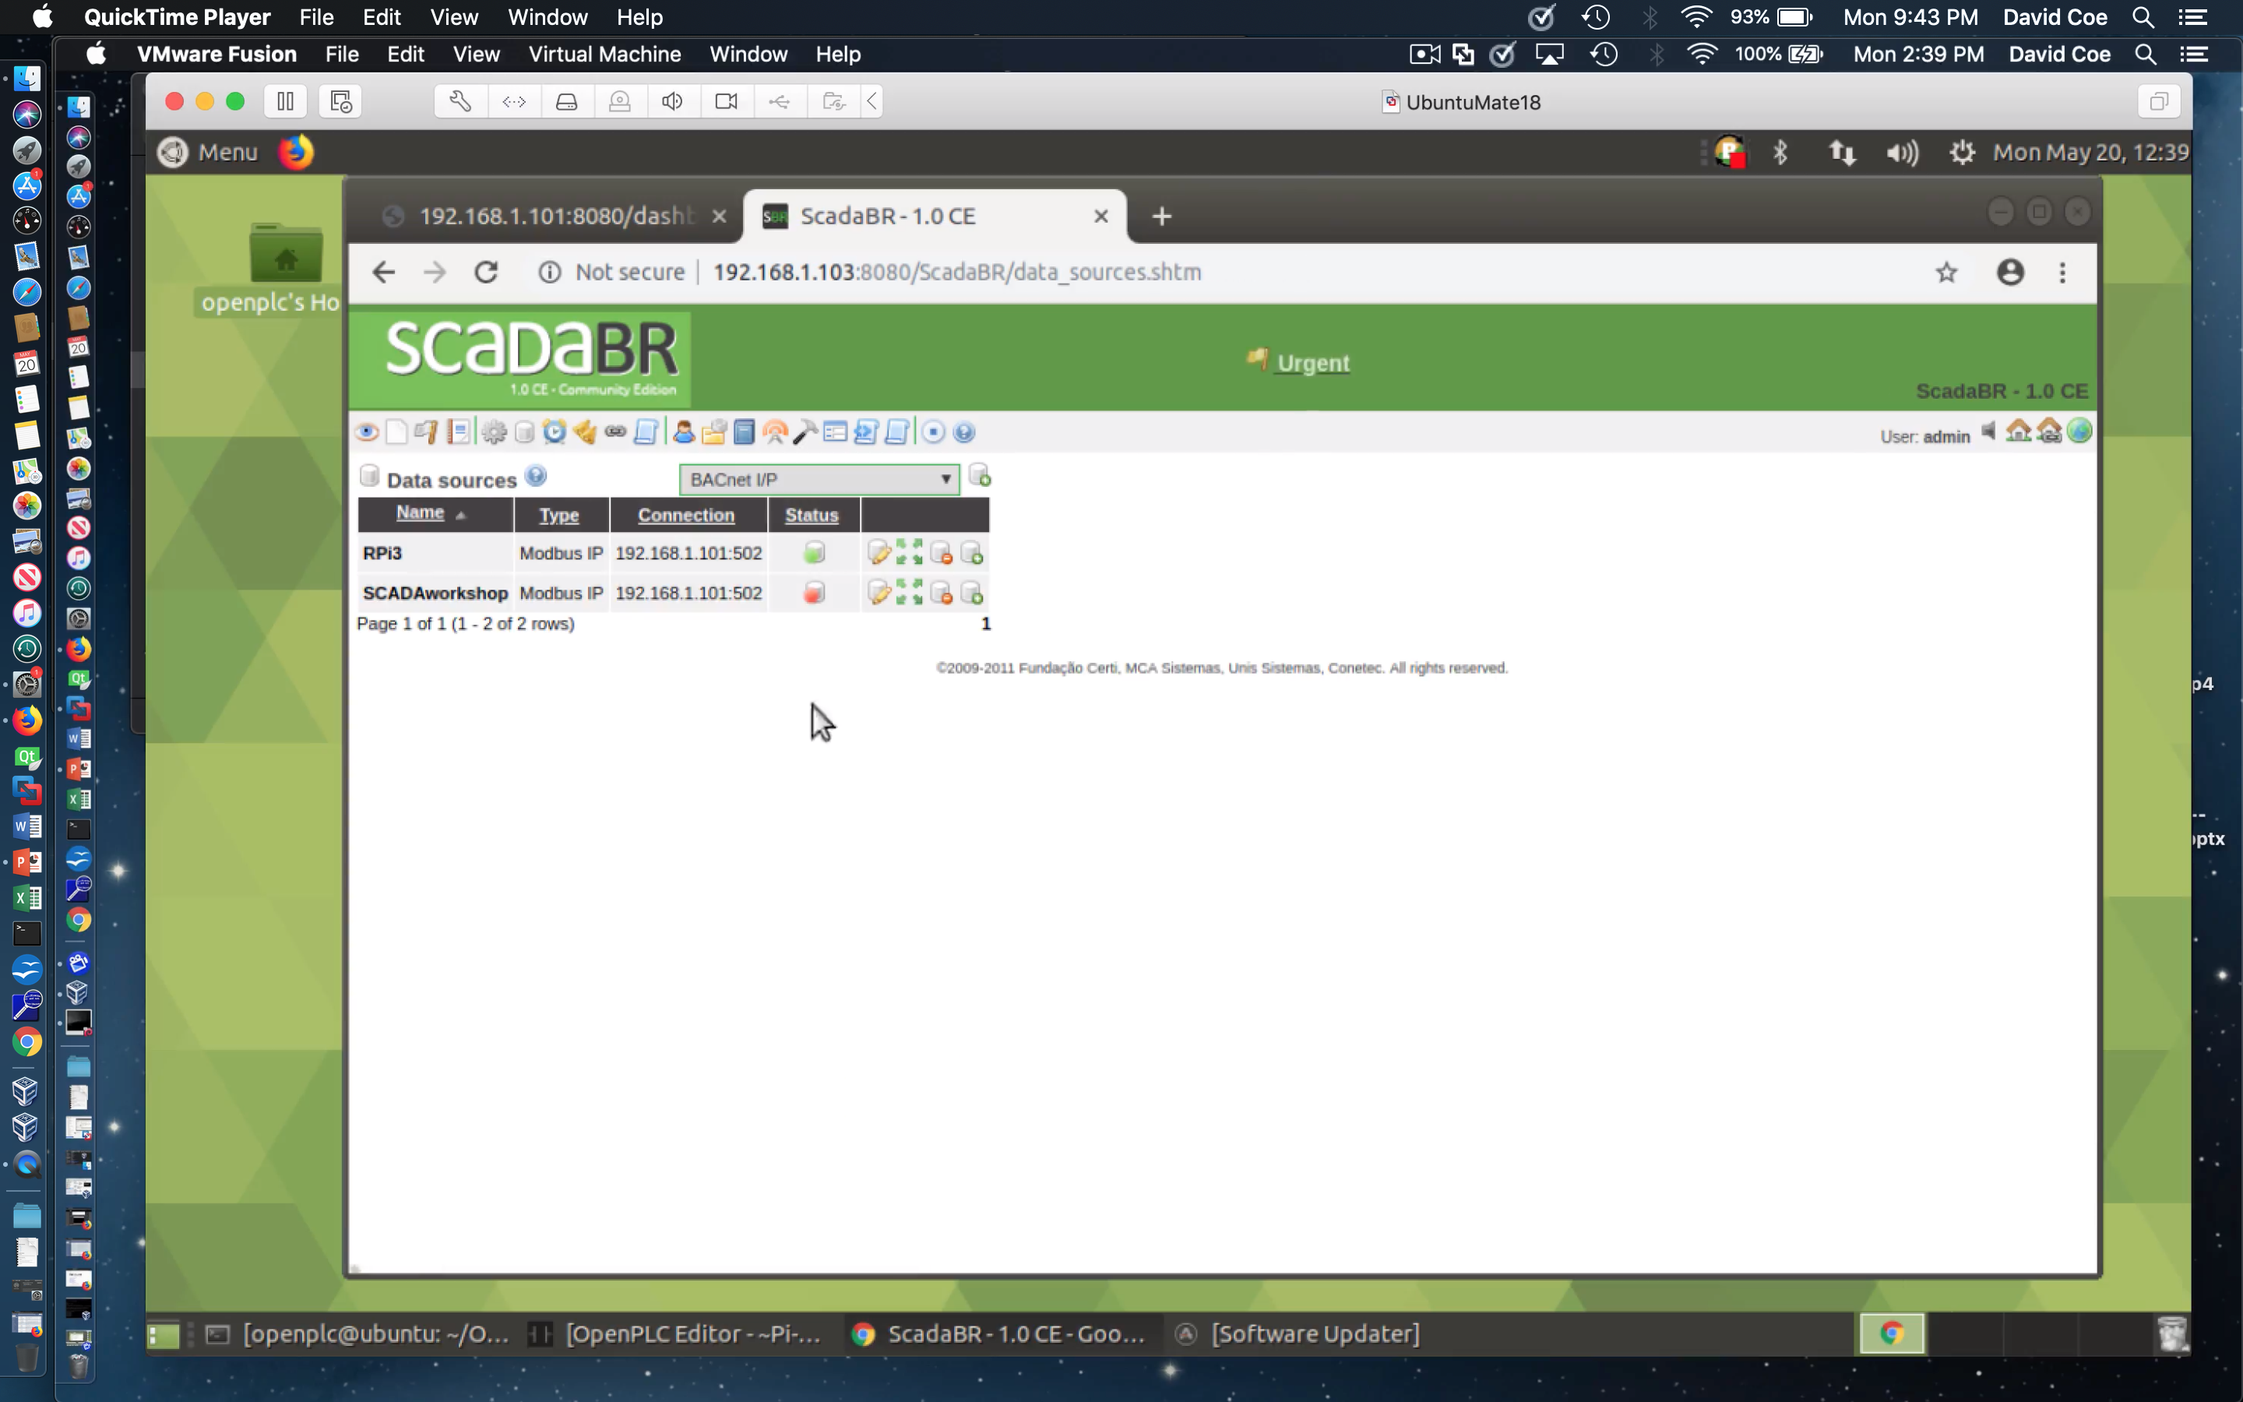
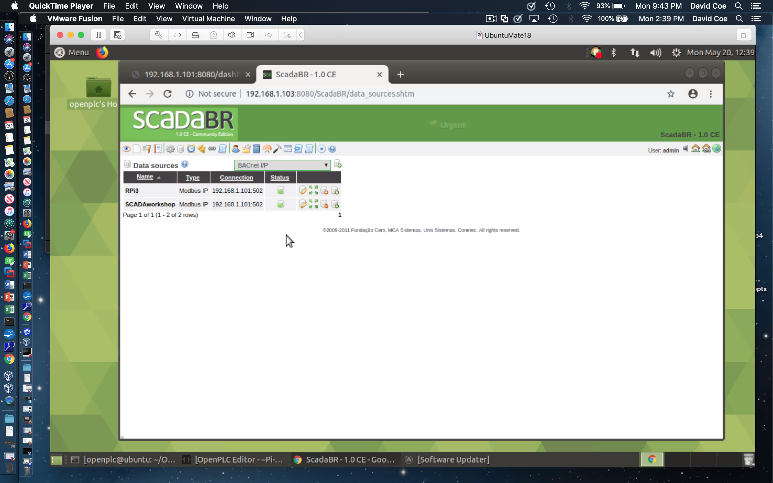
Configuration of Data Source - 12
Click icon under Status to enable

Slide 26
Creating an HMI View

Slide 27

Create an HMI View of Data Points - 1
Hit Graphical view icon

Slide 28
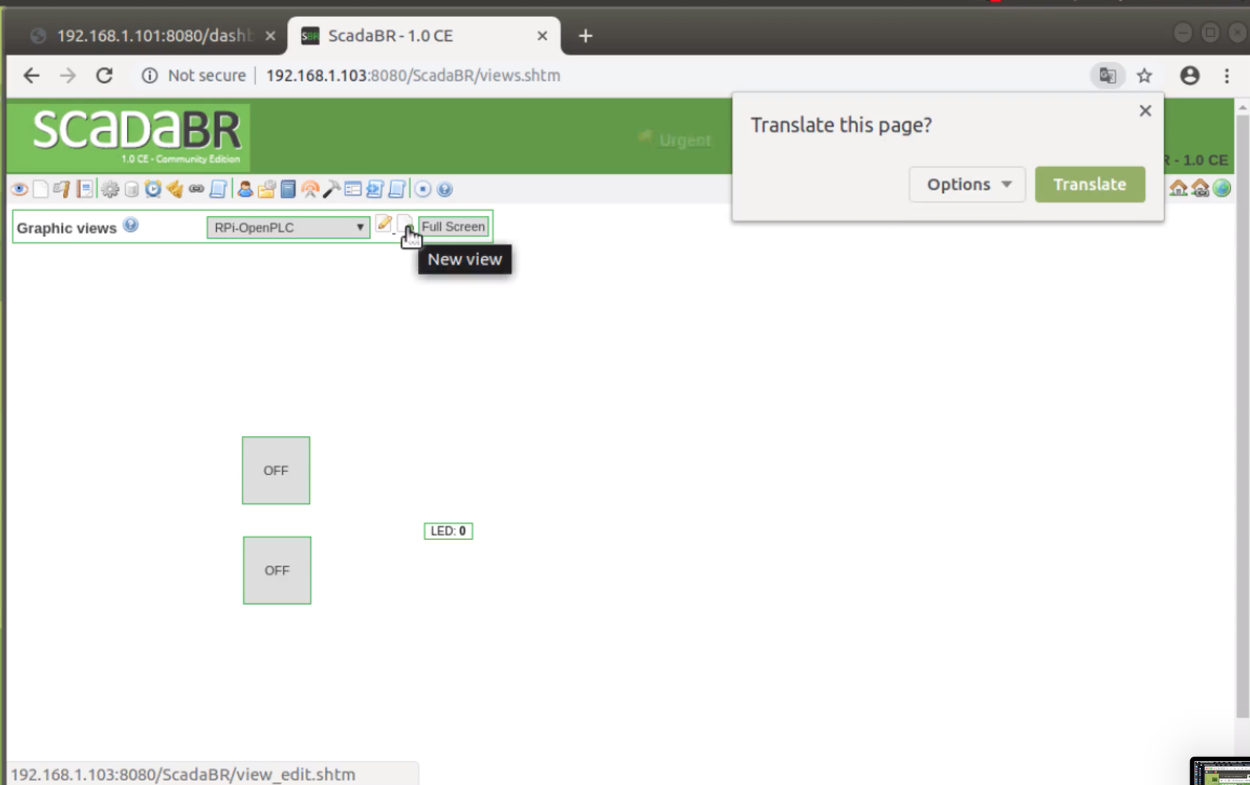
Create an HMI View of Data Points - 2
Hit New view icon

Slide 29
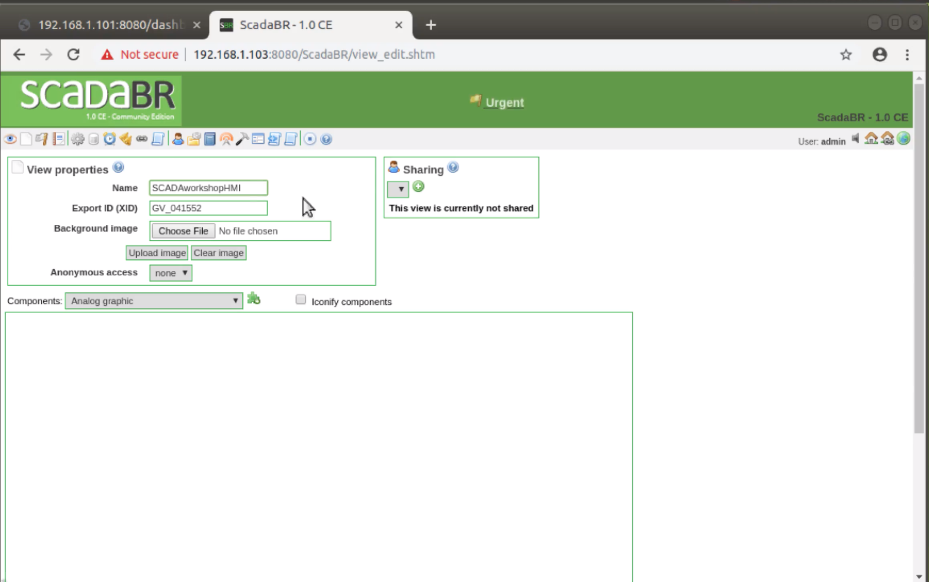
Create an HMI View of Data Points - 3
Enter the name for the new view

Slide 30
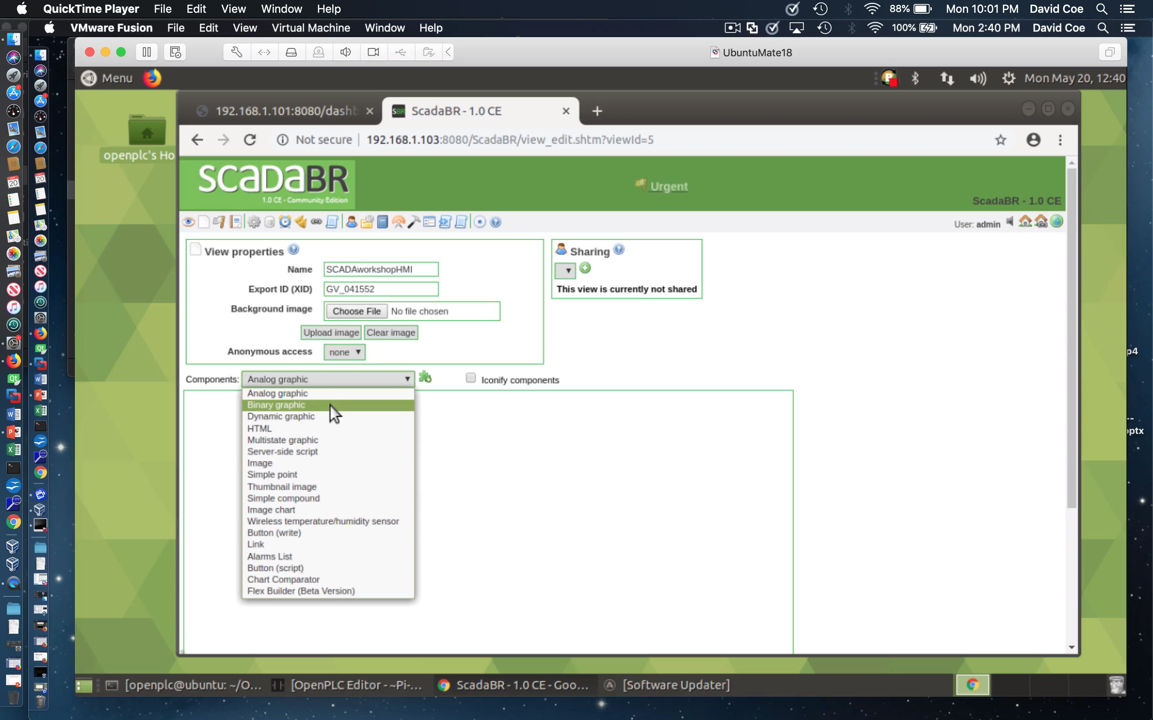
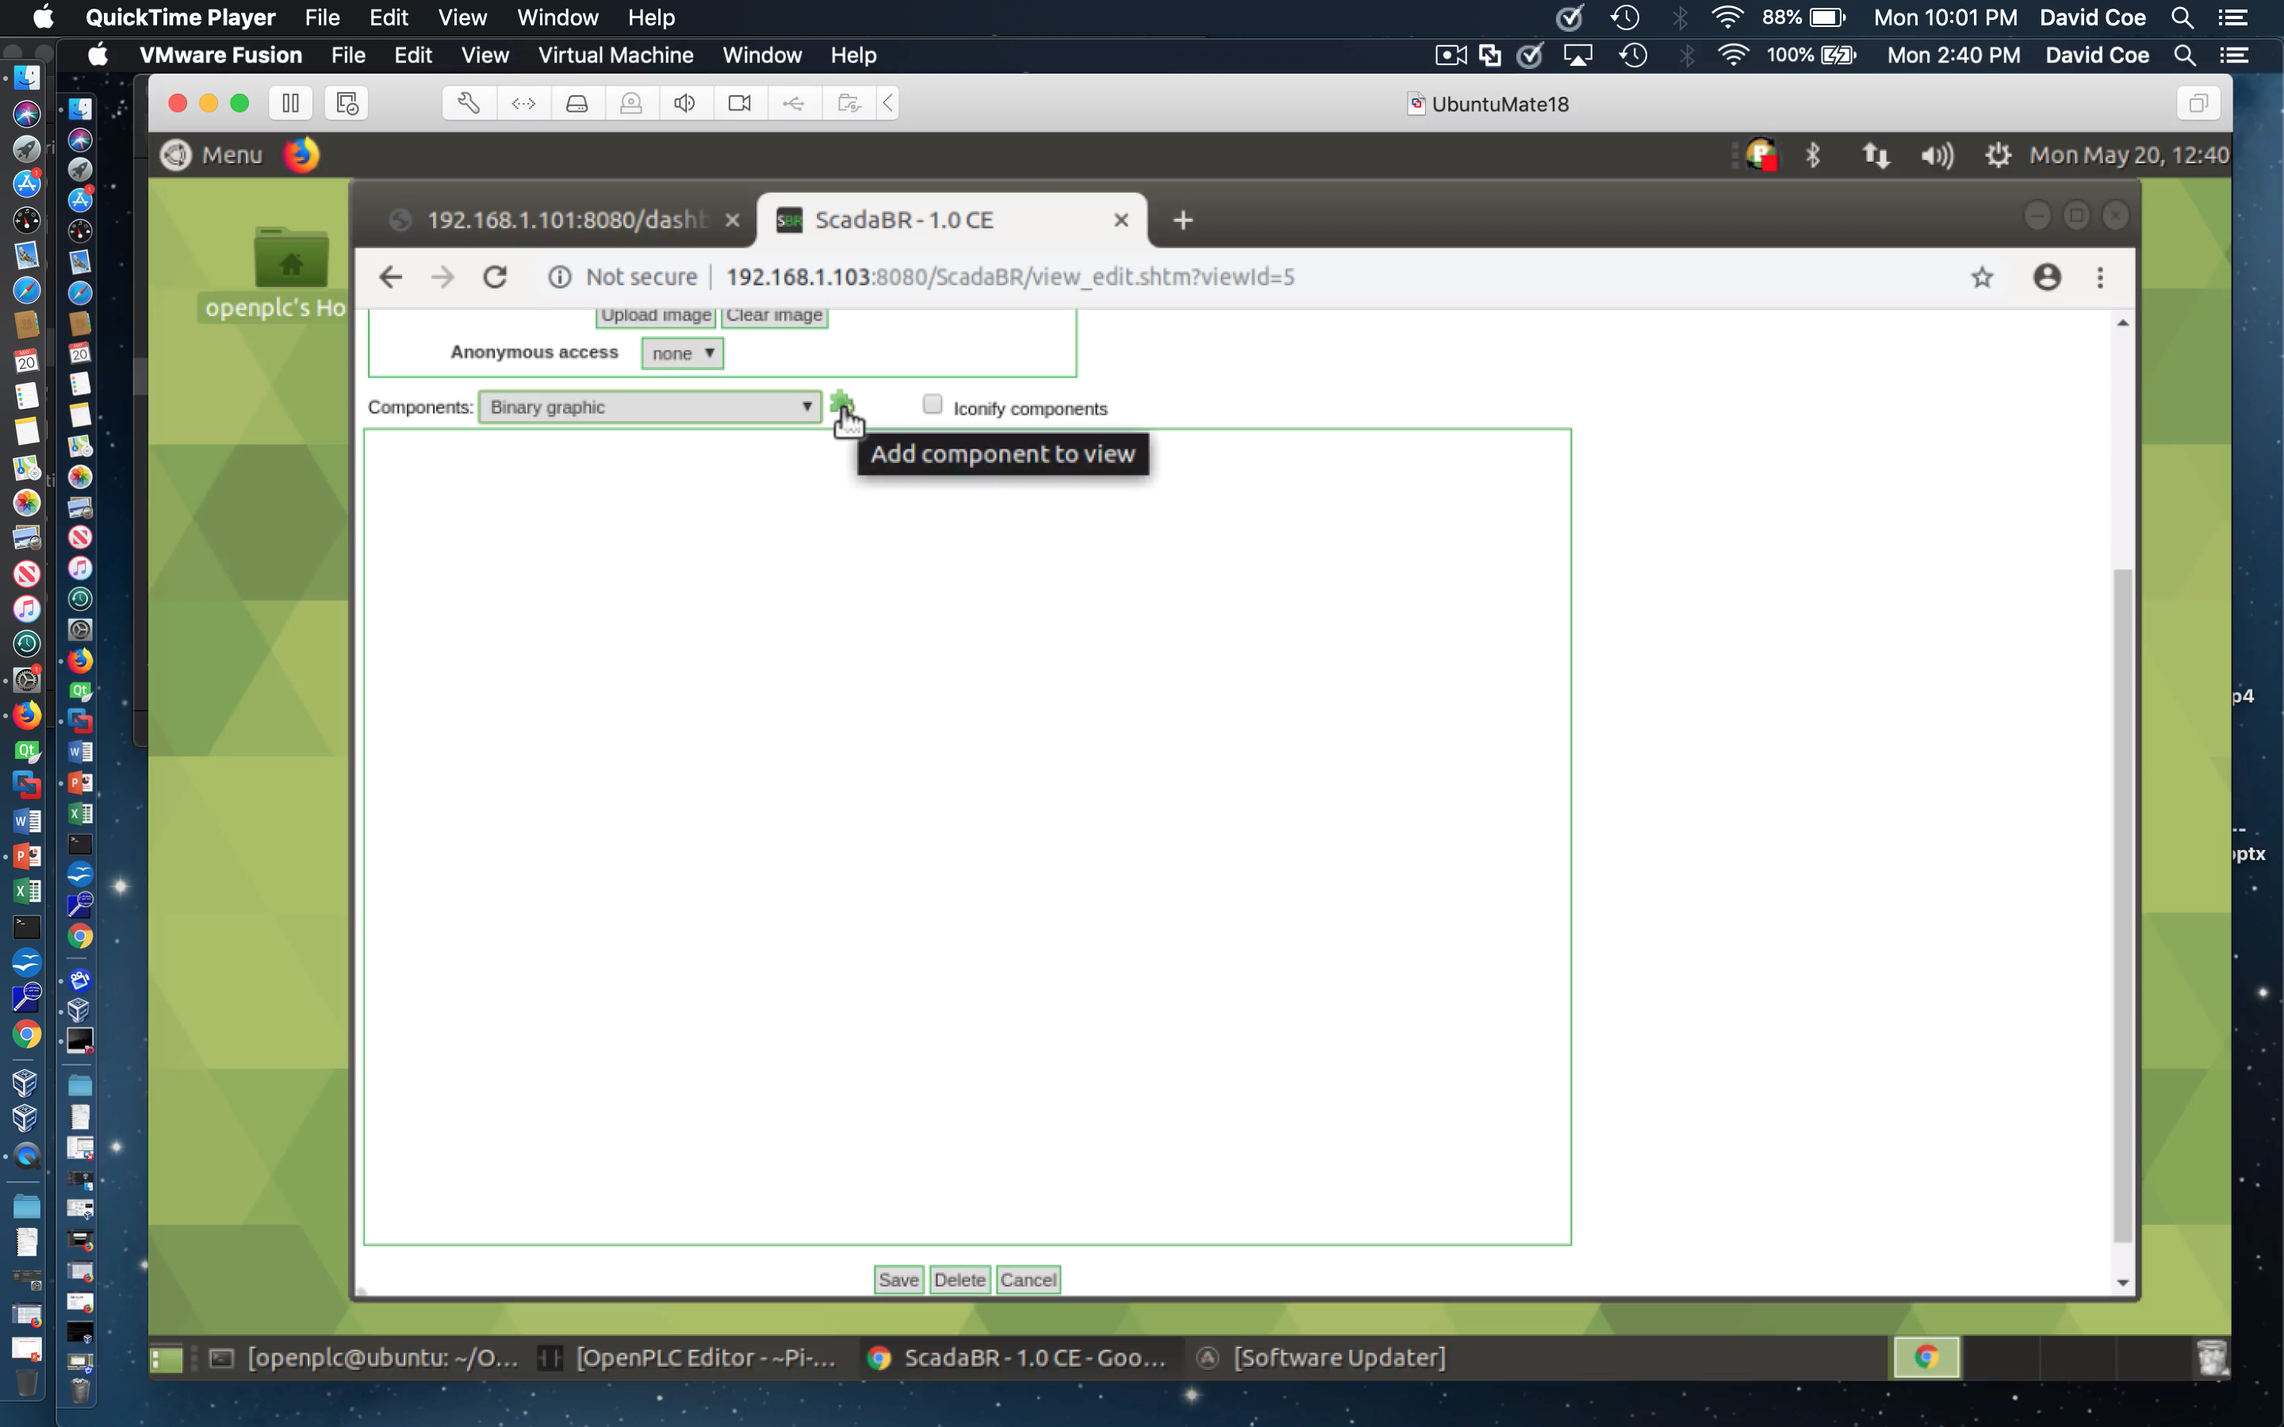
Create an HMI View of Data Points - 4
Add a binary graphic component to the new view

Slide 31
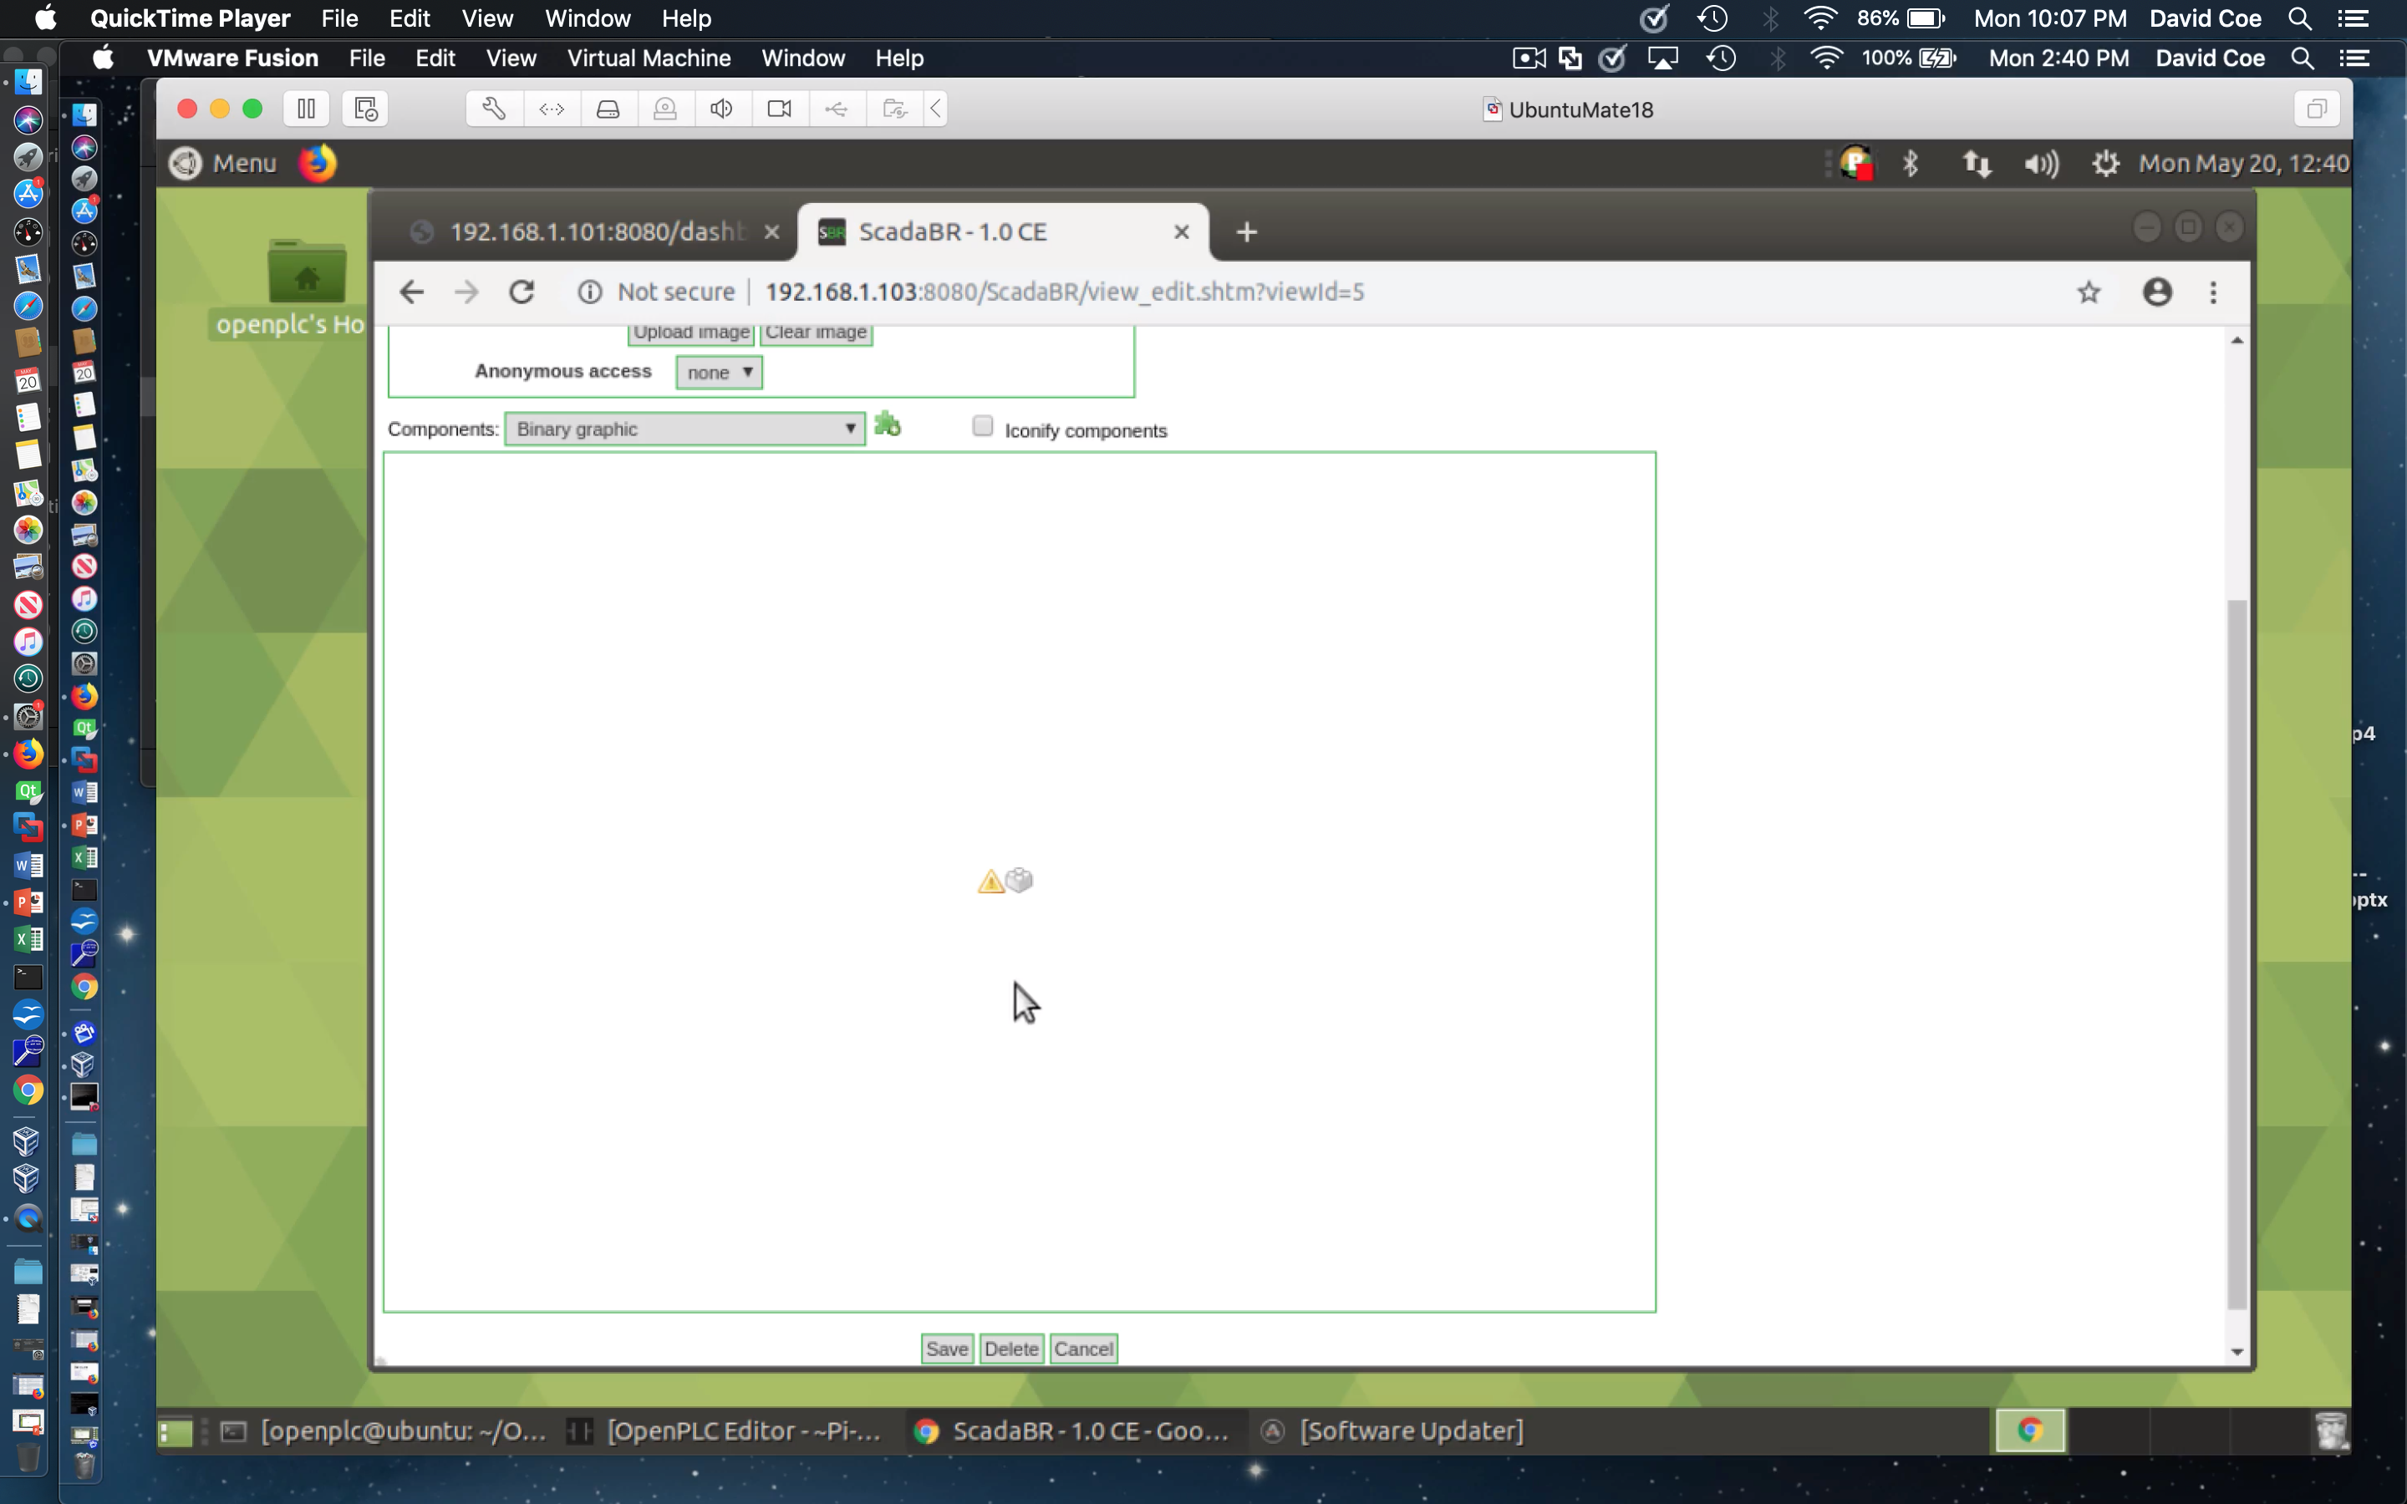

Create an HMI View of Data Points - 5
Binary graphic component to new view
Hover to see component menu

Slide 32
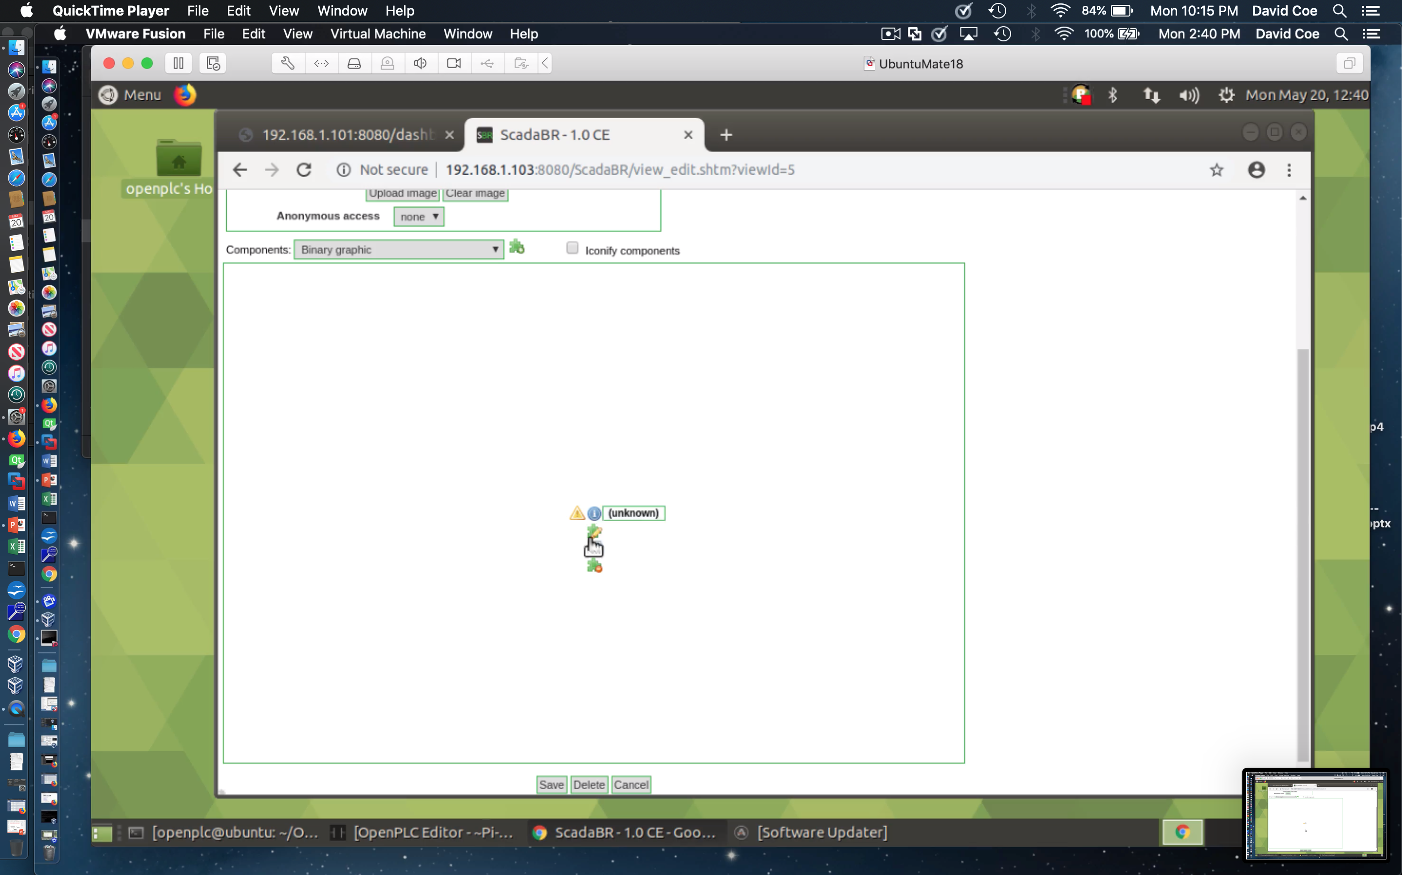
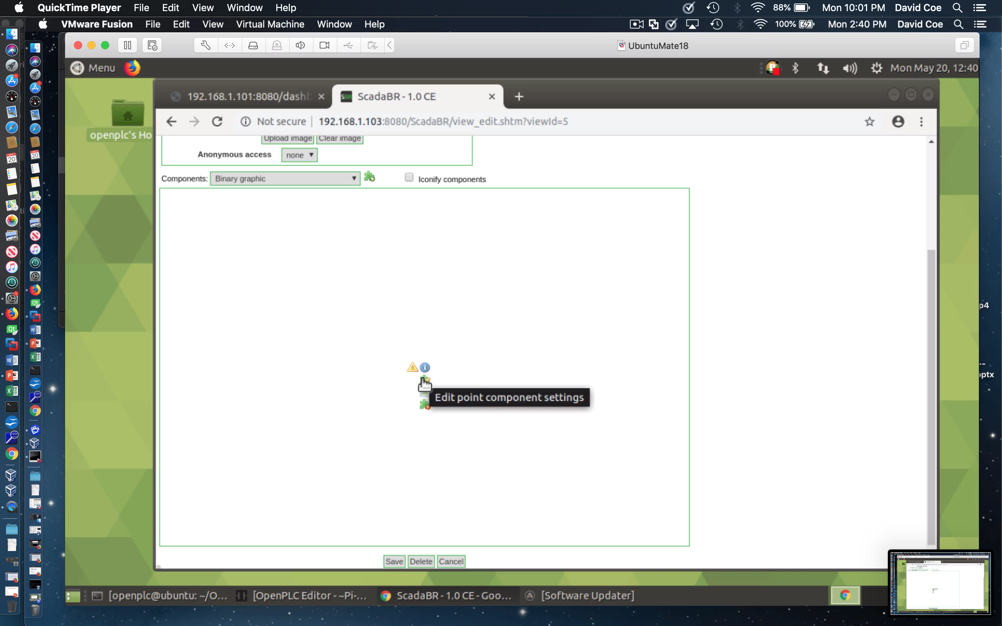


Create an HMI View of Data Points - 6
Each component has multiple options in its pull-down
You will need to make modifications at both places indicated

Slide 33
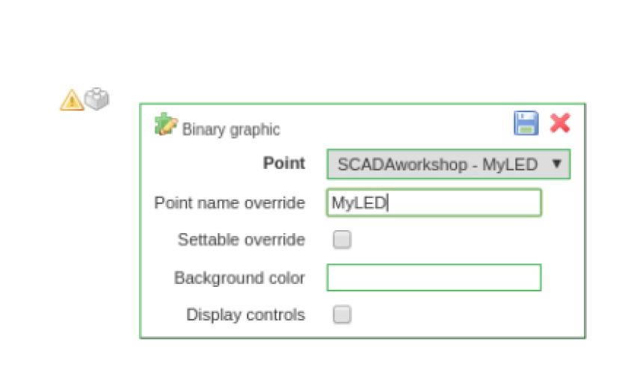
Create an HMI View of Data Points - 7
Select point from data source
Give point shortcut name
Select Save

Slide 34
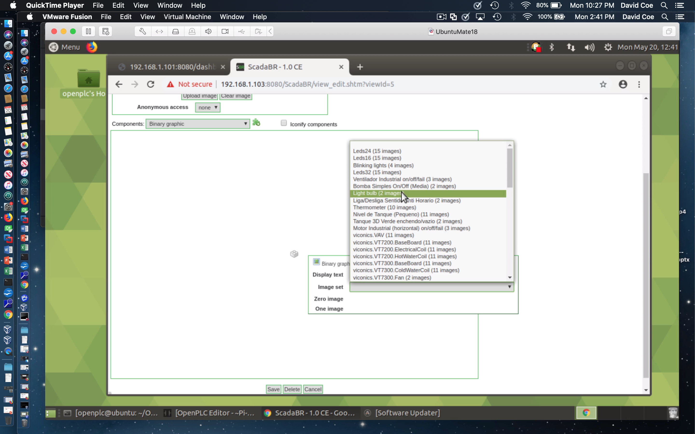

Create an HMI View of Data Points - 8
Select light bulb for Image set
Select image shown for 0 and image shown for 1
Select Save icon

Slide 35
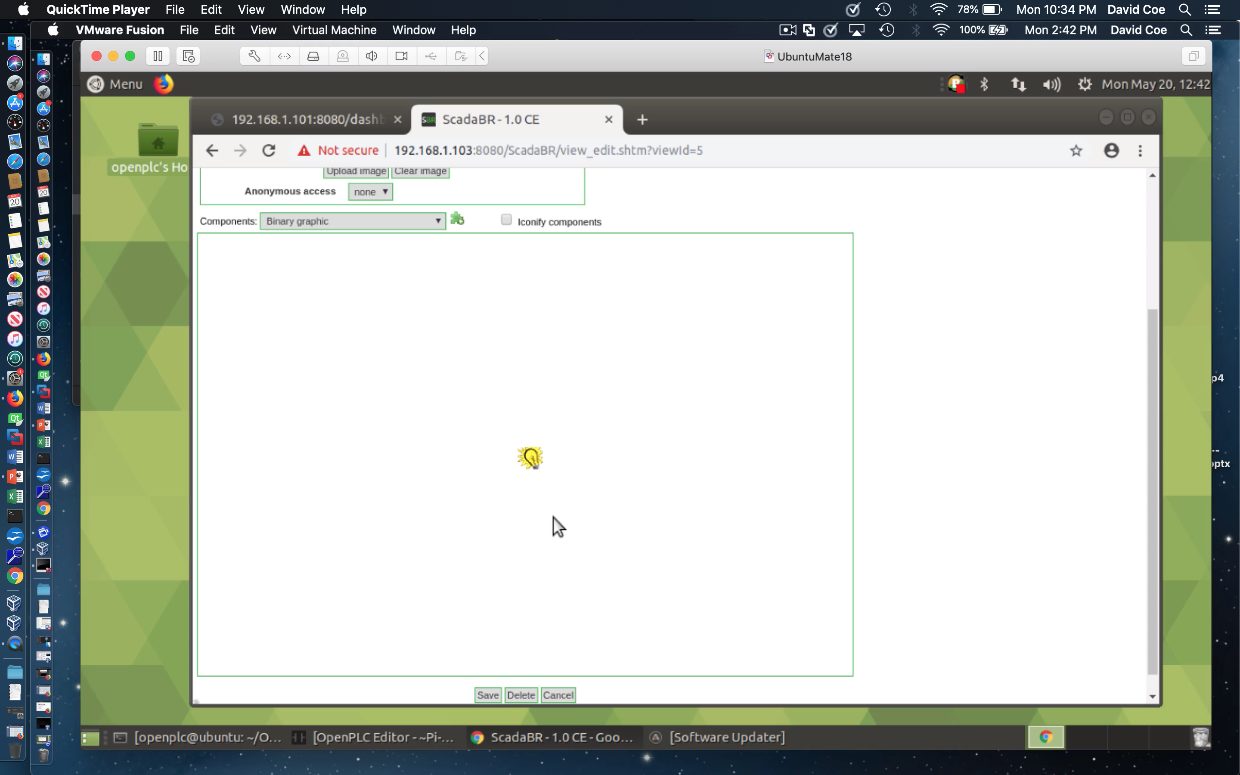

Create an HMI View of Data Points - 9
Press and hold Push Button #2 on physical circuit
Bulb should light when pressed and darken upon release

Slide 36
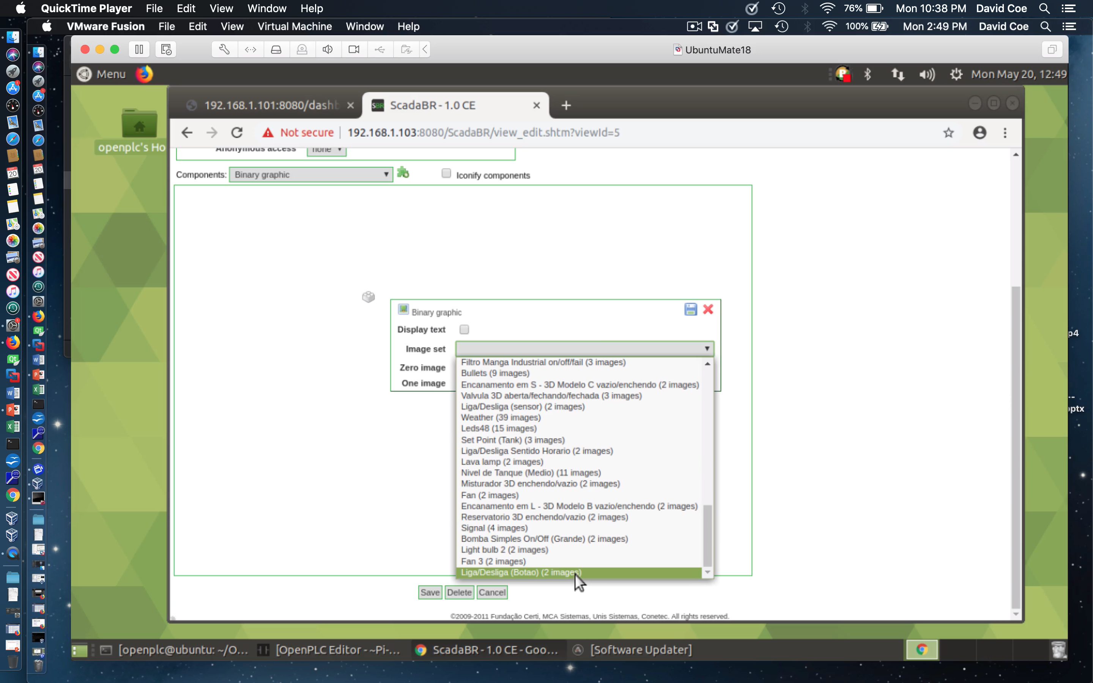
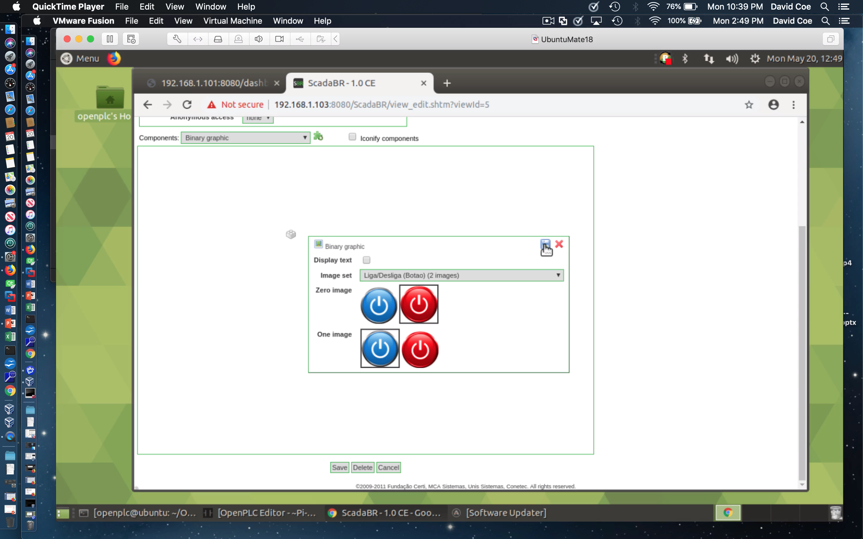
Create an HMI View of Data Points - 10
Add binary graphic components for Button #1 and Button #2
See above for binary image suggestion

Slide 37
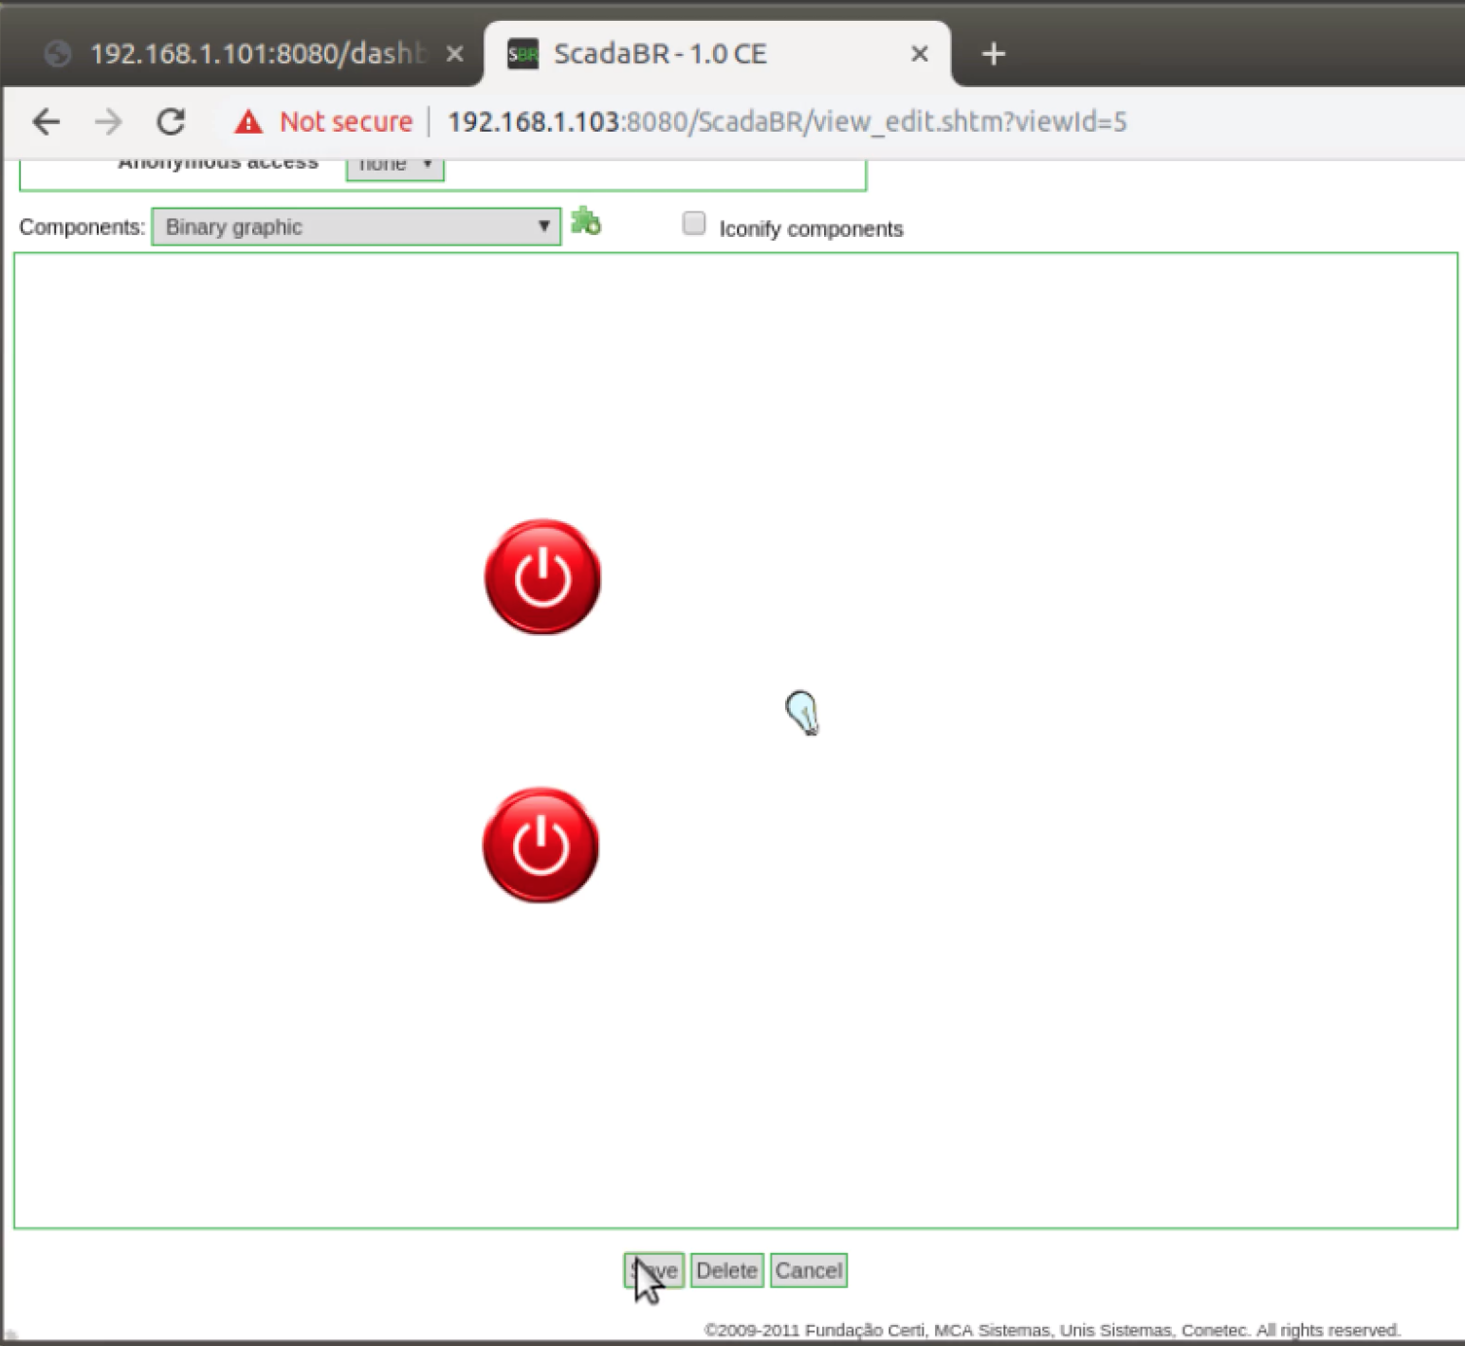
Create an HMI View of Data Points - 11
Hit Save to save work and exit view editor

Slide 38
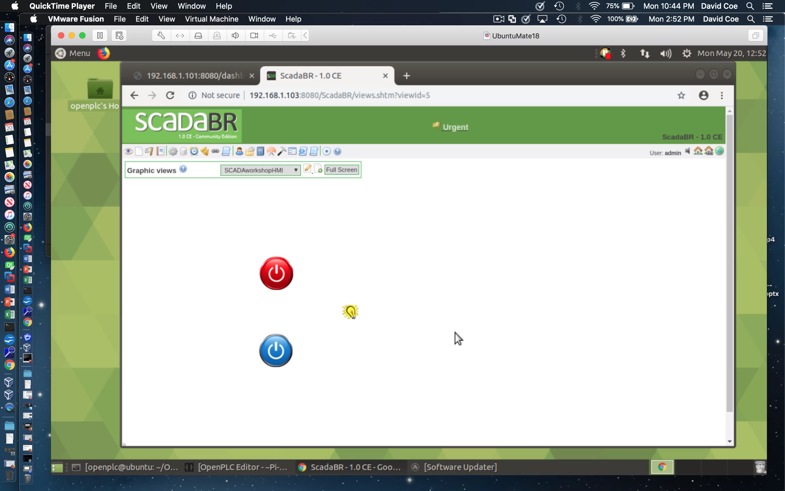
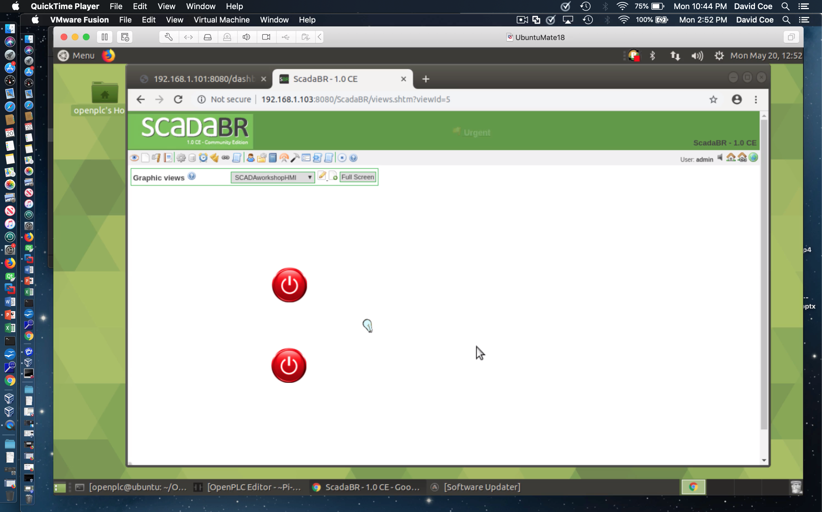
Create an HMI View of Data Points - 12
Press and hold Button #2
Release Button #2
Test operation of HMI view and data source

Slide 39
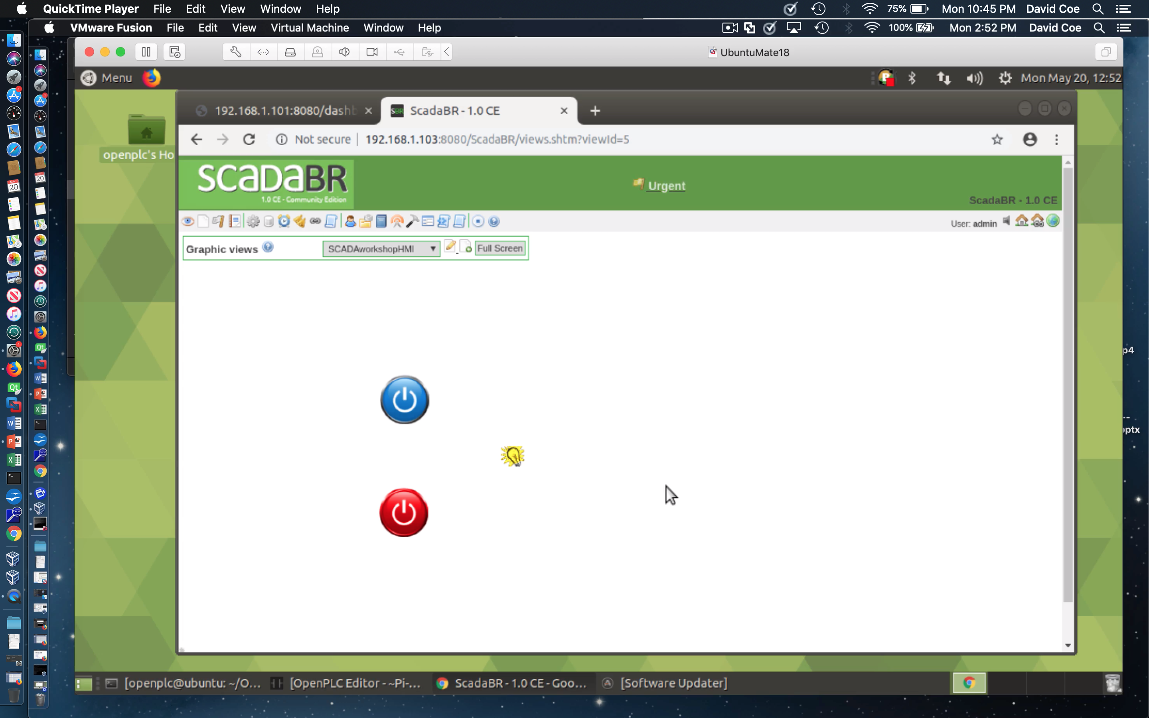
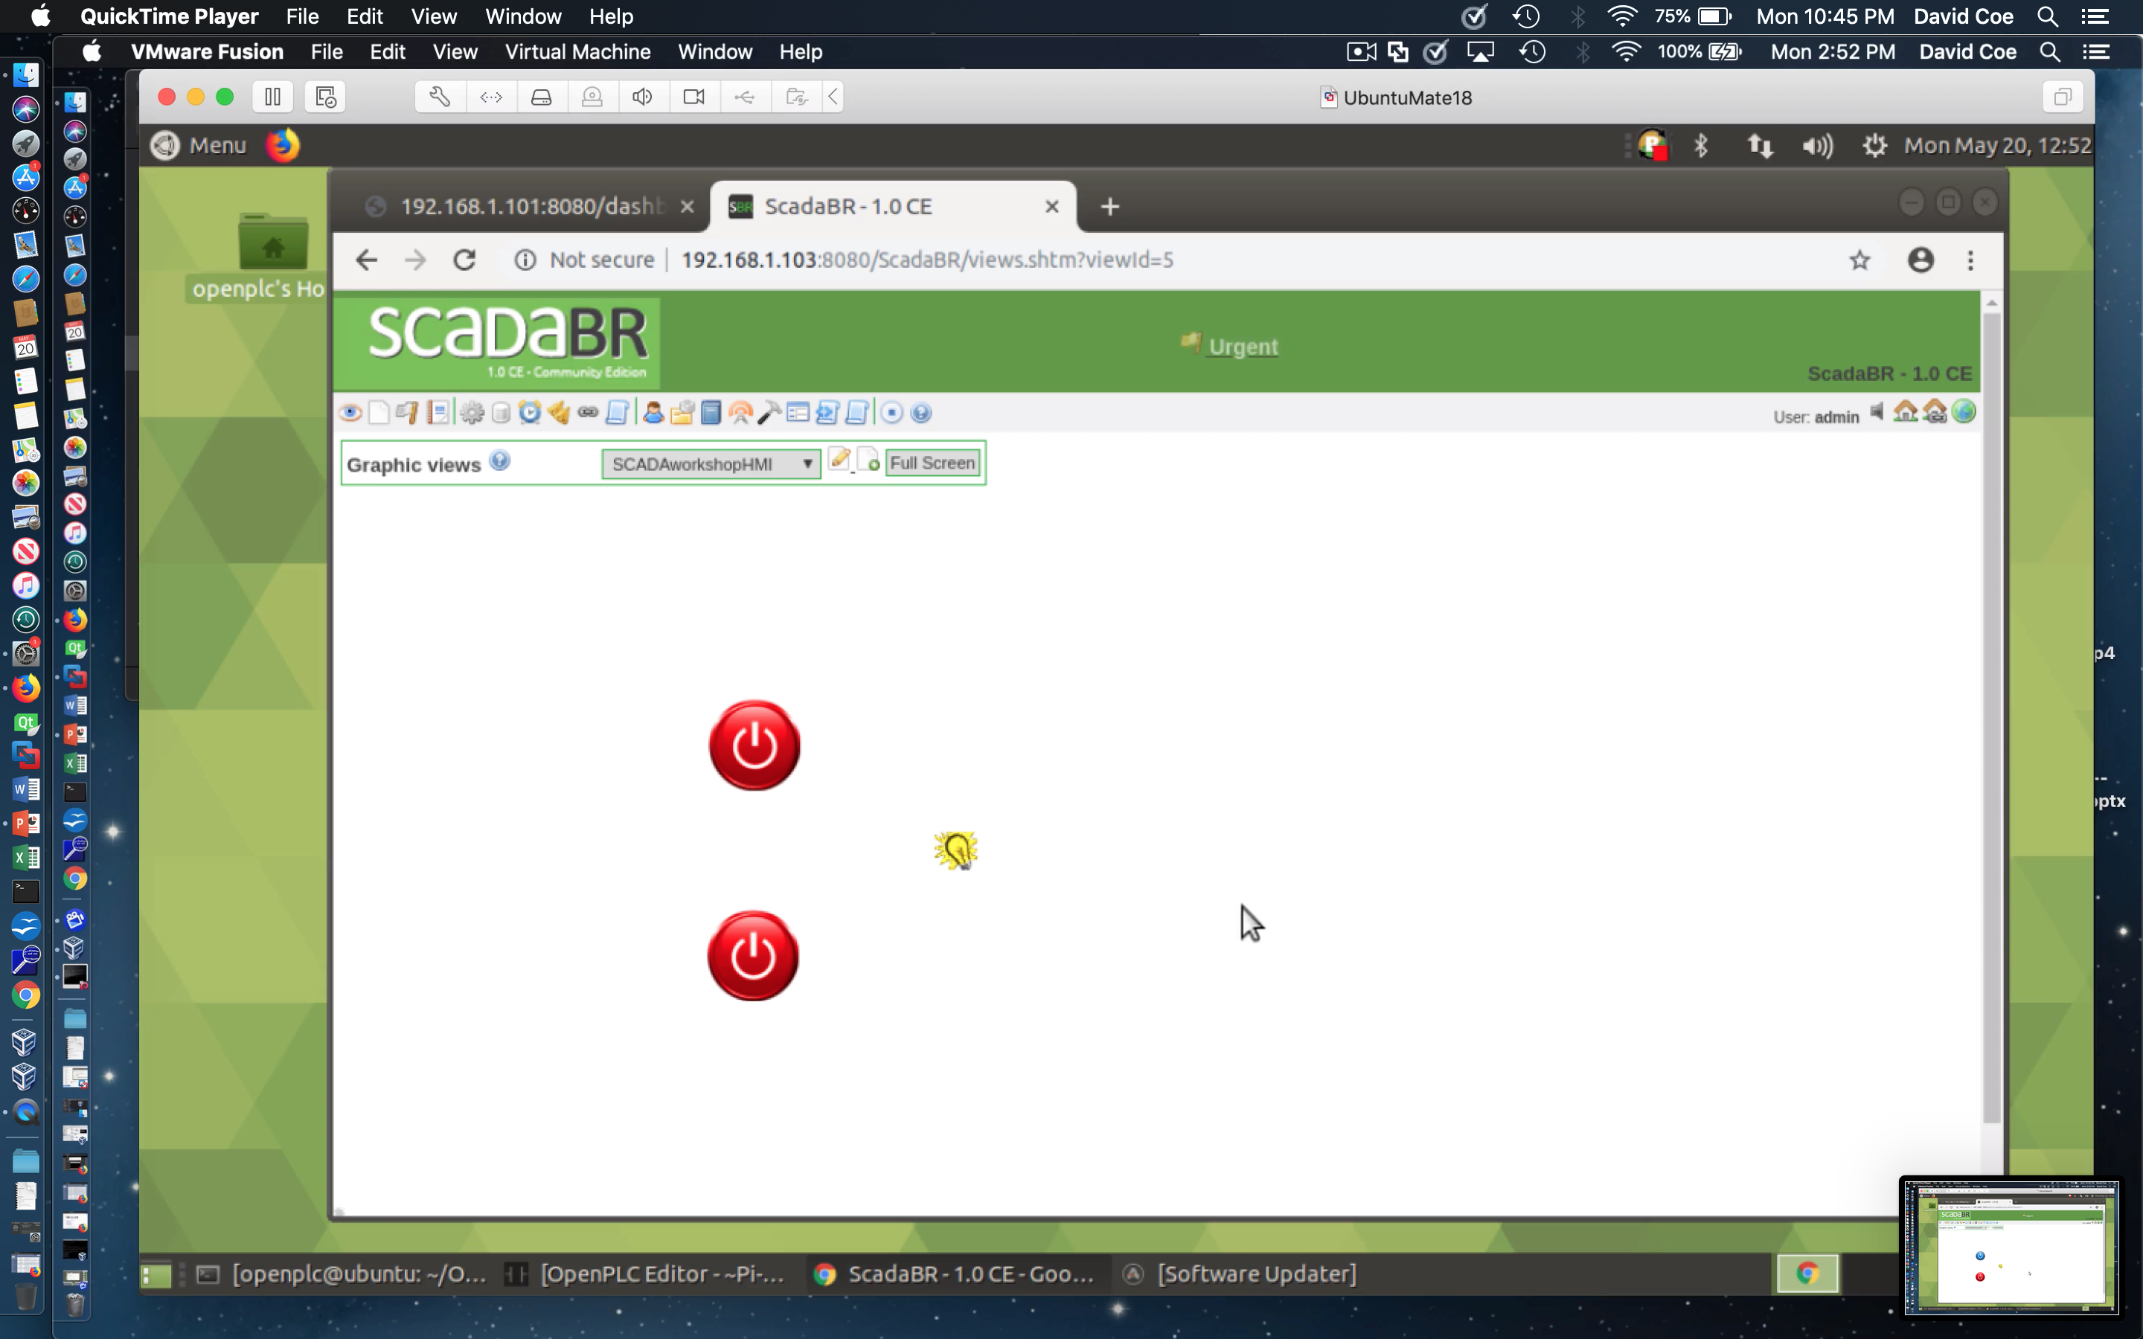
Create an HMI View of Data Points - 13
Press and hold Button #1
Release Button #1
LED remains on for 2 sec
LED now off
Test operation of HMI view and data source

Slide 40
Suggested Reading
The OpenPLC Project
https://www.openplcproject.com/
Tommy Morris – Six SCADA Modules
https://clark.center/details/tommy_morris/Six%20SCADA%20Modules

Slide 41
Hands-On Laboratory Exercise #4

Slide 42
Laboratory Exercise #4 Instructions - 1
Objectives
Learn how to use ScadaBR to create a simple Human-Machine Interface (HMI) for the First Project Ladder Logic program
Learn how to test your HMI’s ability to interact with an executing OpenPLC program

Slide 43
Laboratory Exercise #4 Instructions - 2
Be sure your OpenPLC runtime is actively executing the First Project Ladder Logic as described at the URL
https://www.openplcproject.com/reference-your-first-project
Create a simple HMI for your First Project program using one Simple Point to show the status of each push button and one Simple Point to show the status of the LED coil
You may use the same binary graphics presented earlier in this lecture
You may also explore alternate options for the LED such as the Lava Lamp
https://www.openplcproject.com/reference-your-first-project

Slide 44
Laboratory Exercise #4 Instructions - 3
Demonstrate HMI operation by replicating all possible push button states (as previously done with the simulator) but this time you will be using the physical circuit buttons
https://www.openplcproject.com/reference-your-first-project

Slide 45
Laboratory Exercise #4 Instructions - 4
Sample Deliverables
Zip file of entire project directory including structured text code
Screenshots of HMI output for each possible combination of input states

